Slide 1
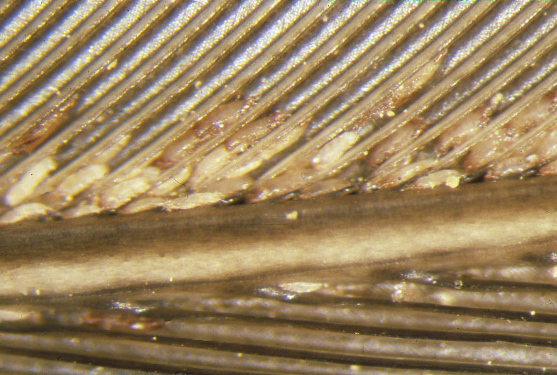
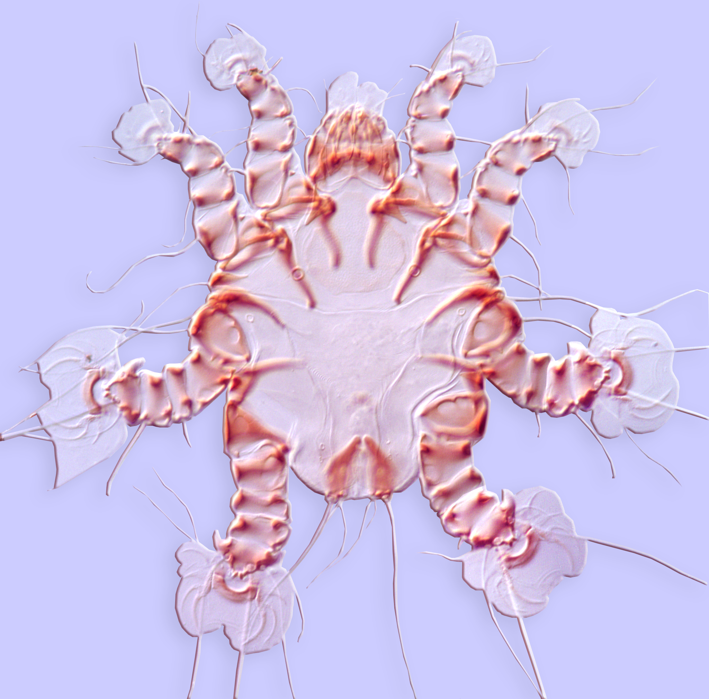
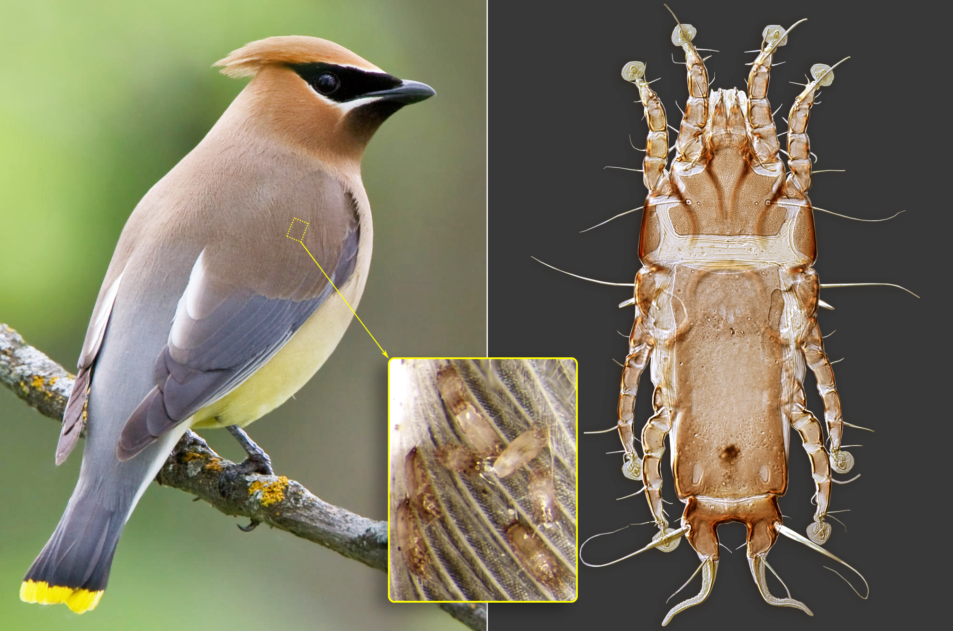
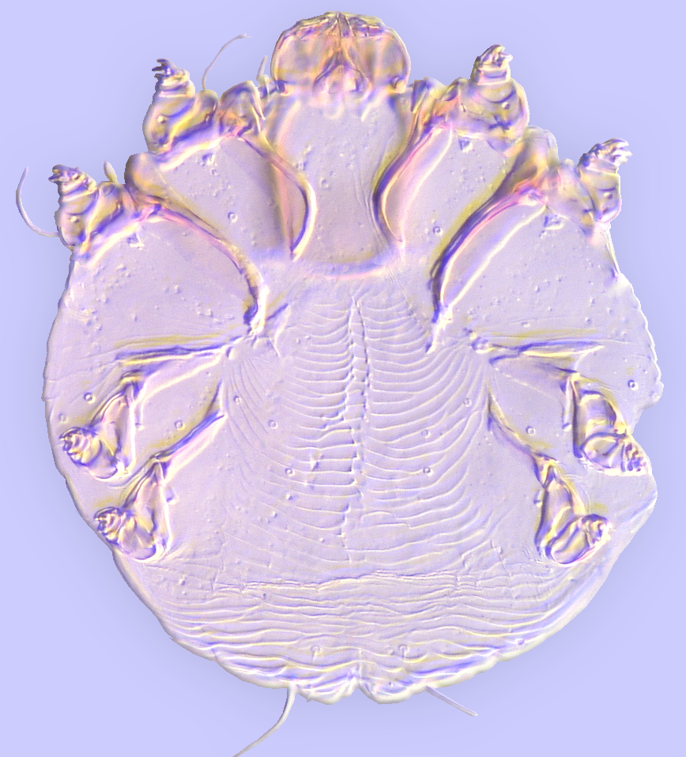
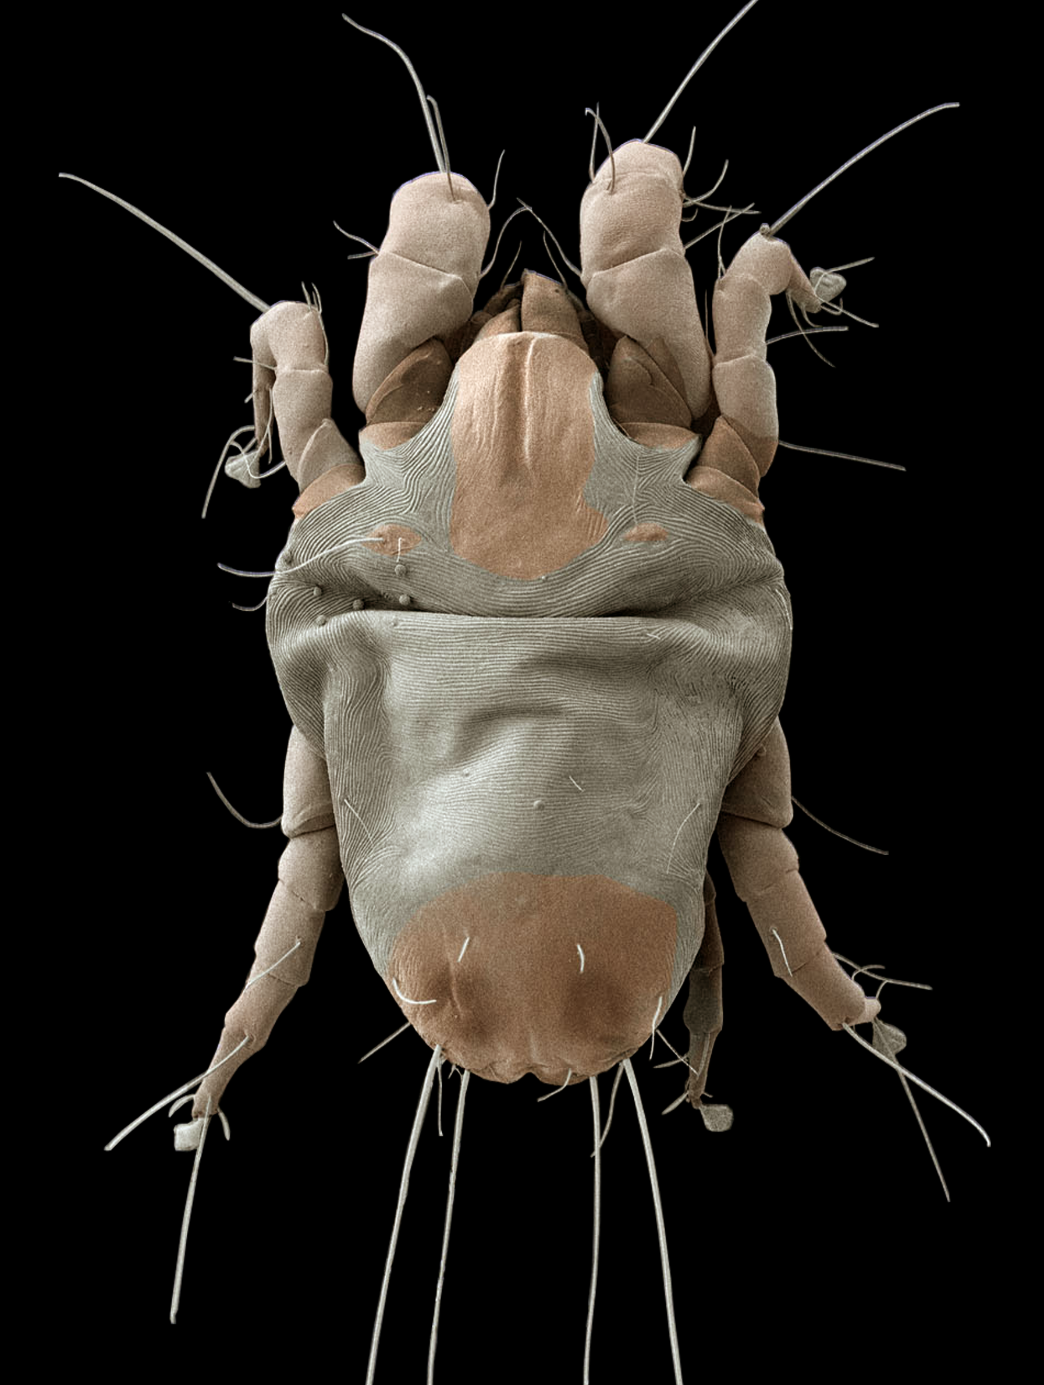
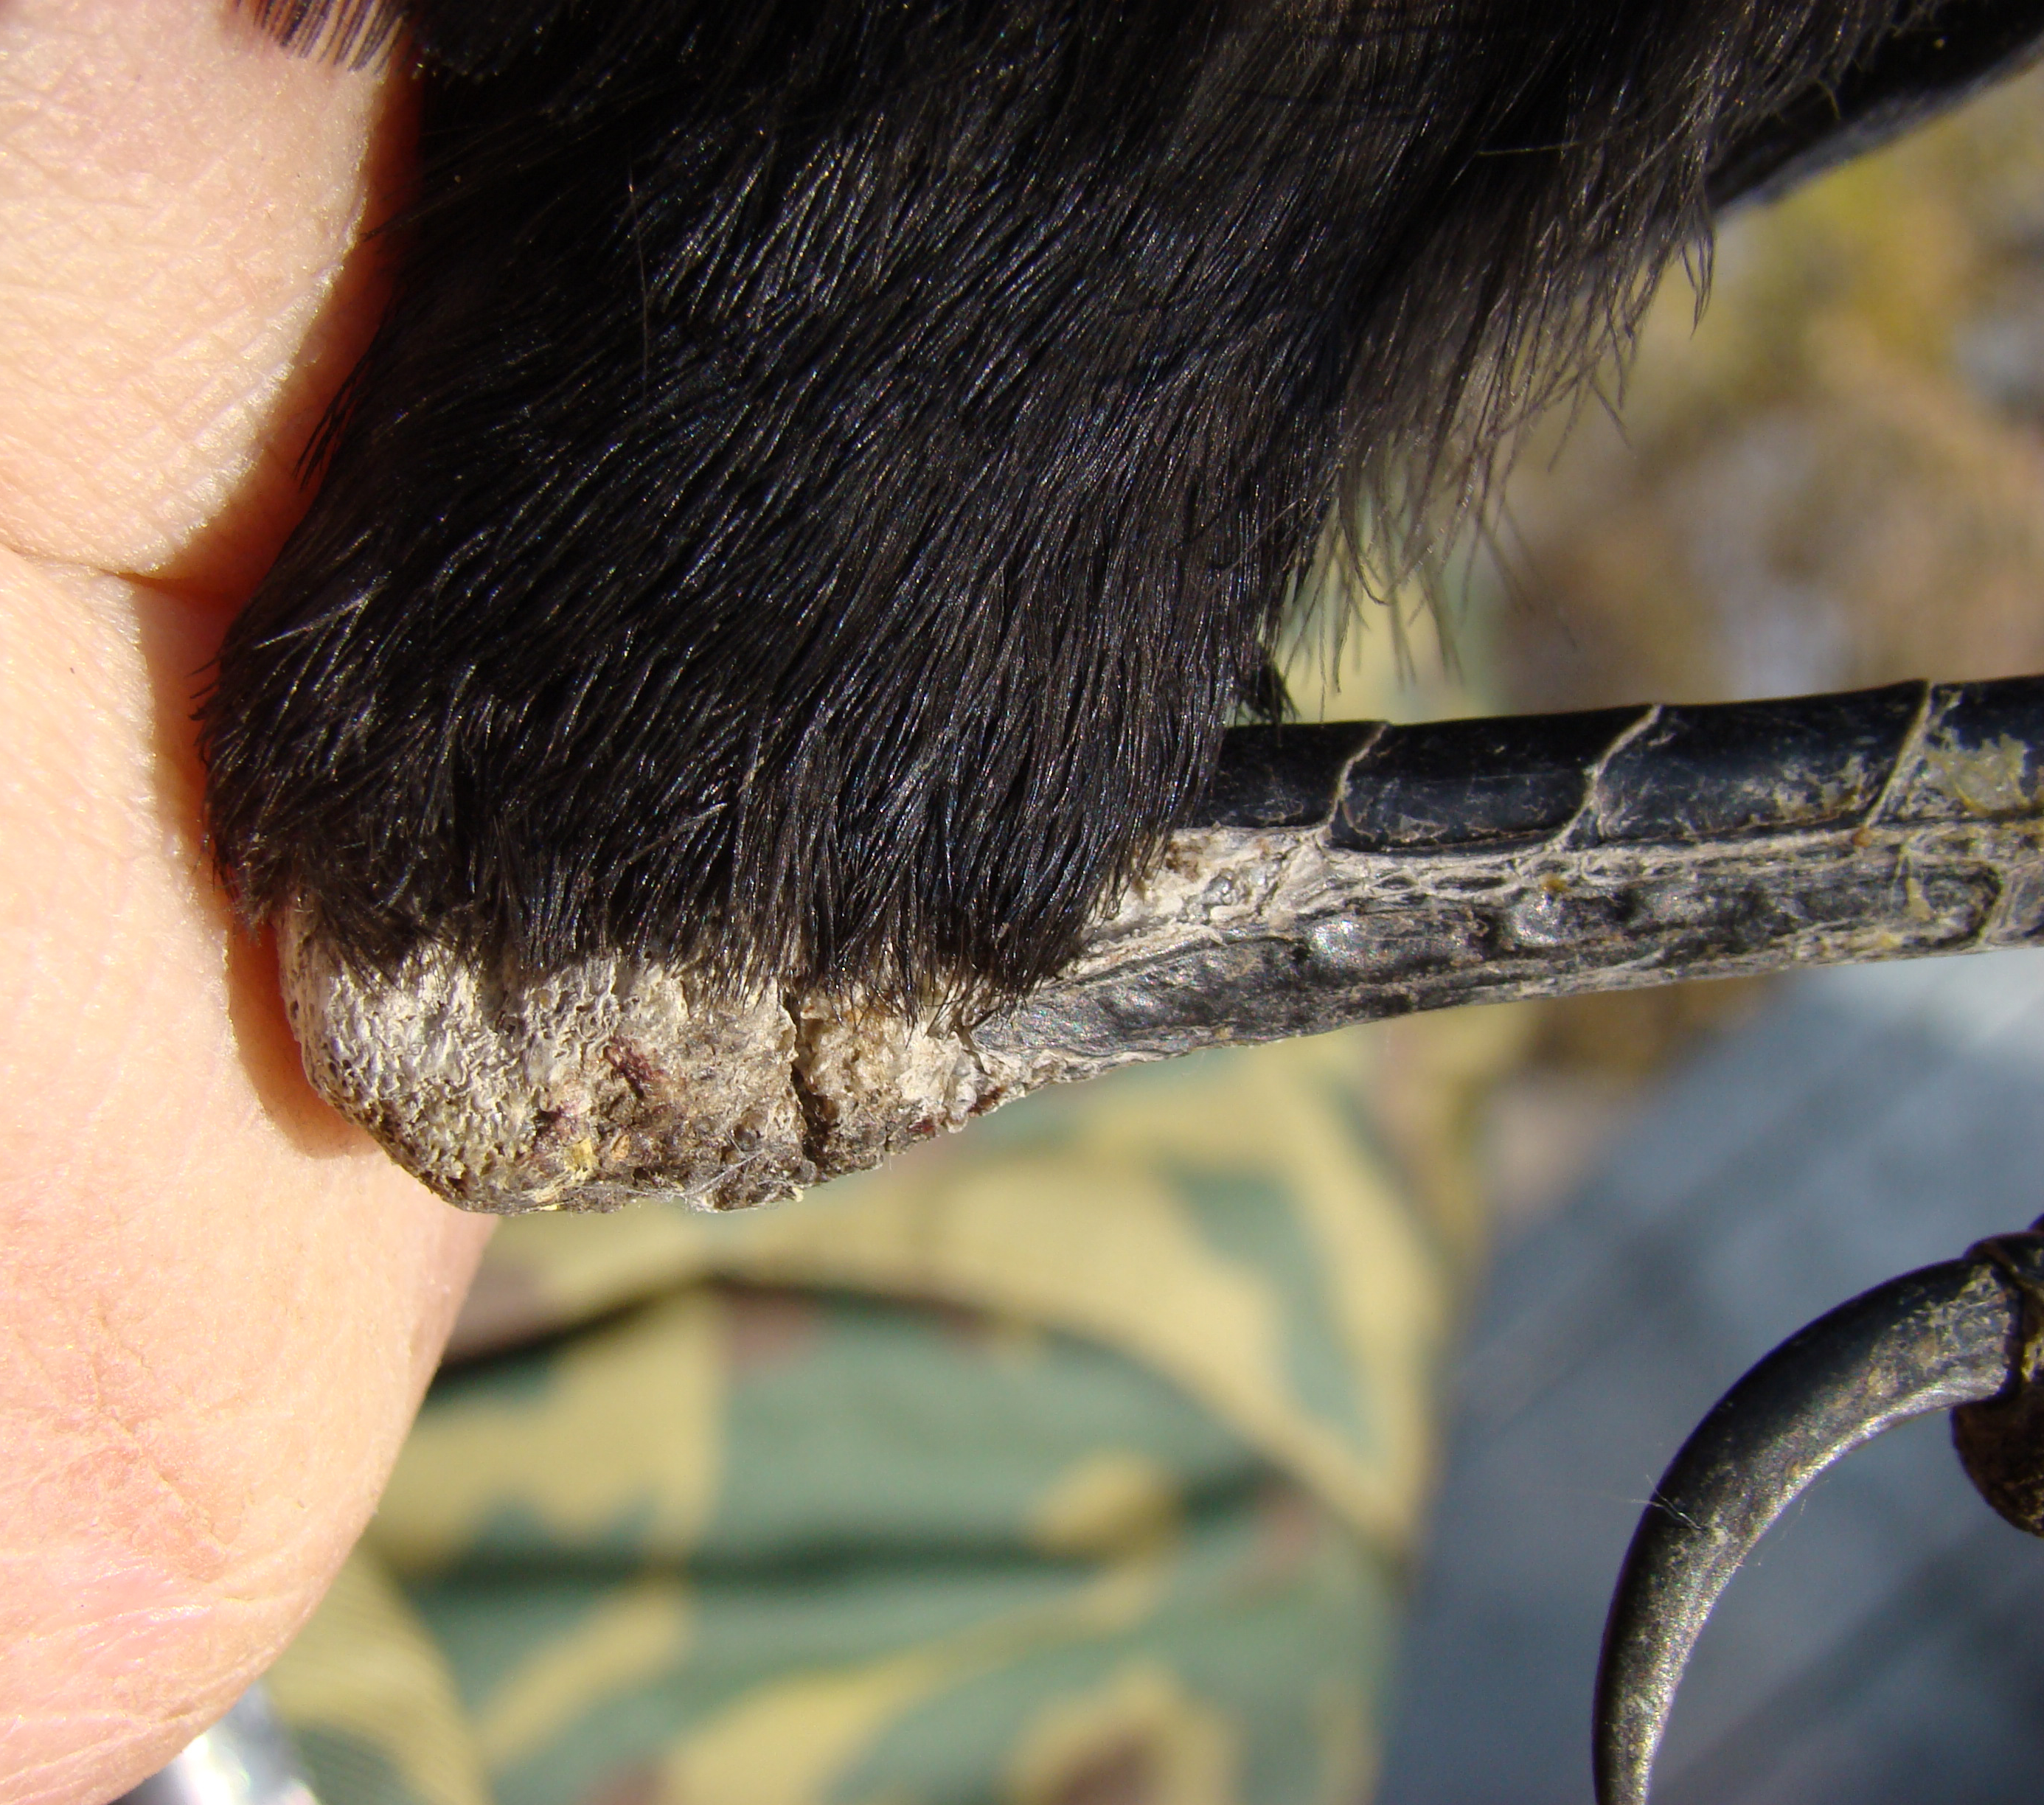
Astigmatid Mites of
Medical-Veterinary Interest-III:
Parasites of birds
Barry M. OConnor & Pavel Klimov
Museum of Zoology & Department of Ecology
& Evolutionary Biology University of Michigan
Ann Arbor, MI 48109

Slide 2
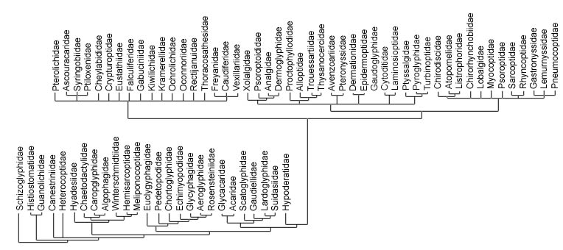
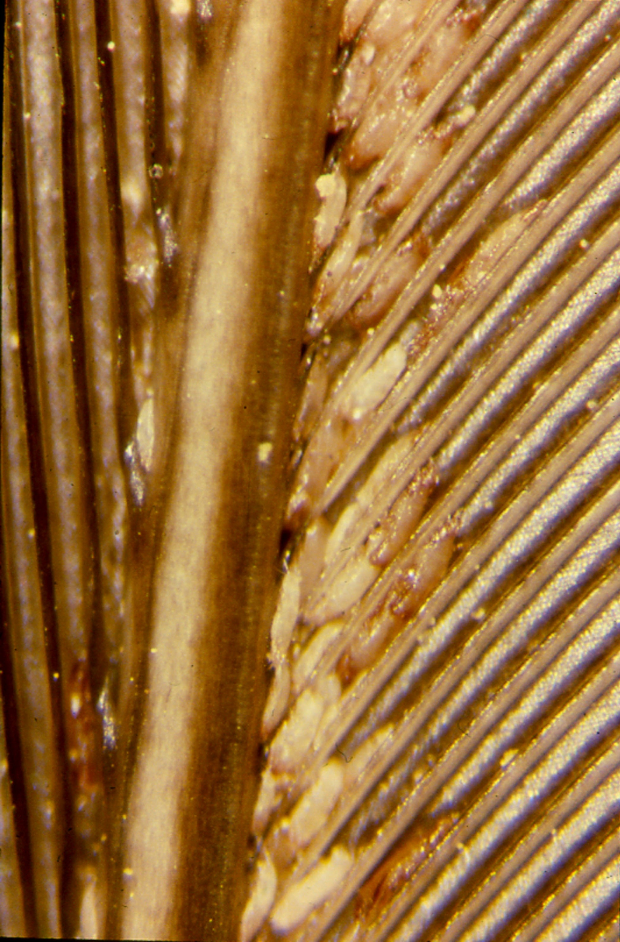
Permanent parasitism
Bird parasites

Slide 3
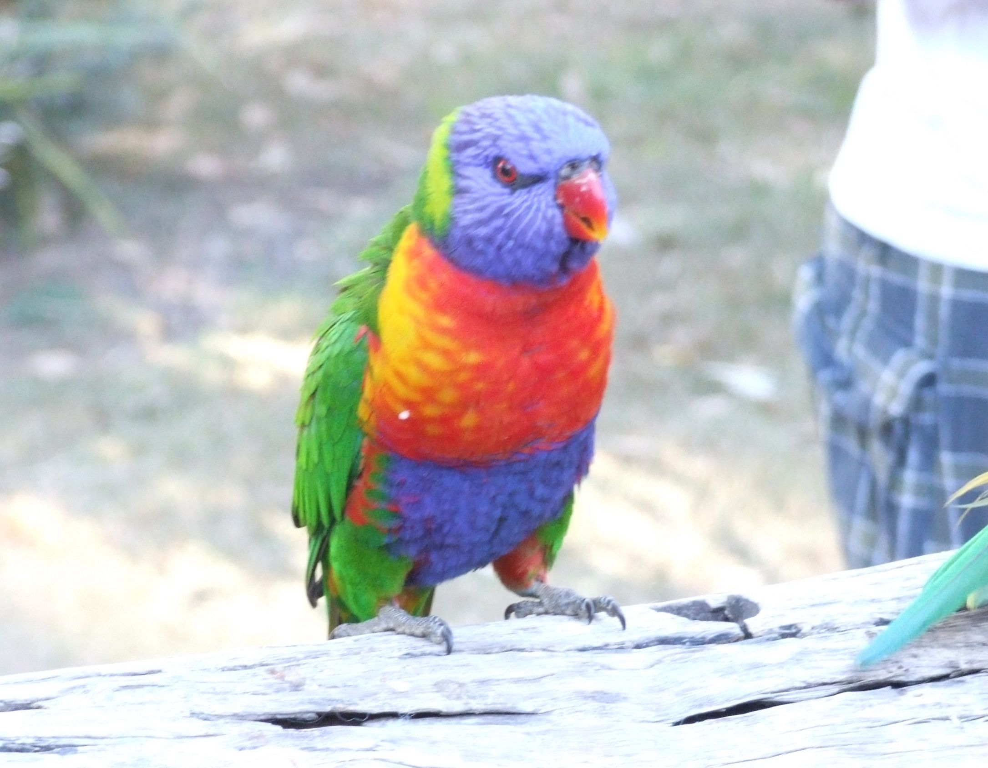
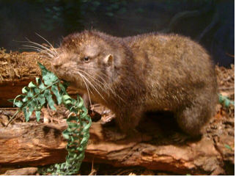
The Psoroptidia has diversified much more greatly in
association with birds than with mammals. Why?
Rainbow lorikeet
Mountain beaver

Slide 4
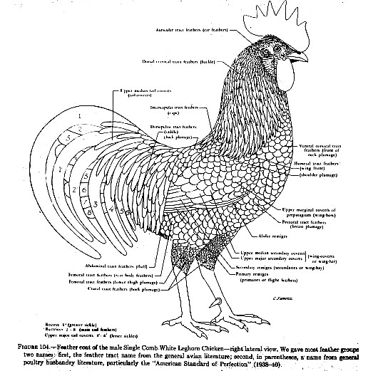
Birds provide a much greater range of microhabitats in which mites can live than mammals do!

Slide 5
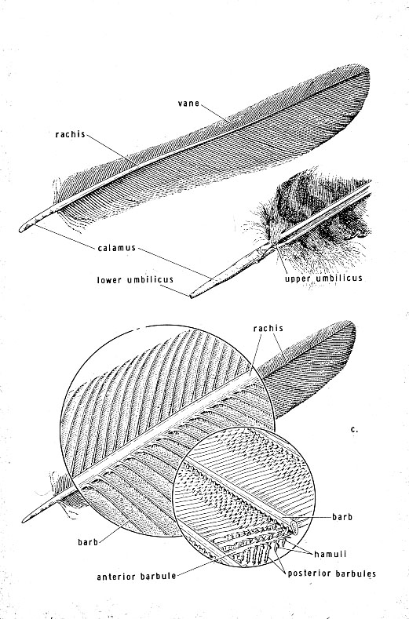
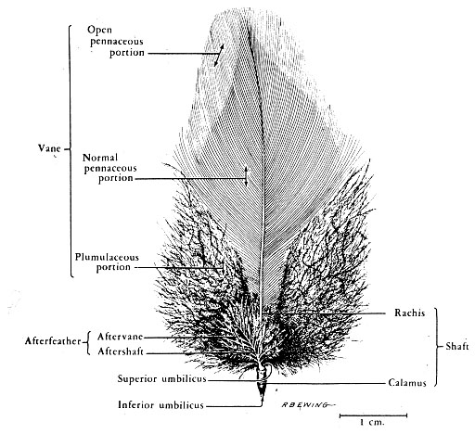
Feathers have complex structure

Slide 6
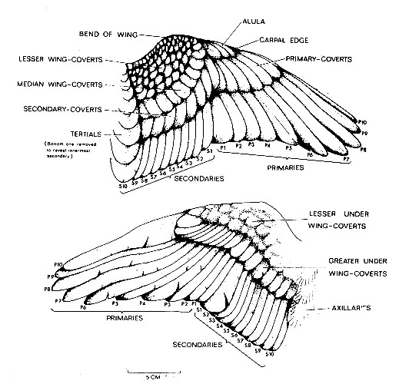
Feathers occur in tracts; each feather is somewhat different

Slide 7
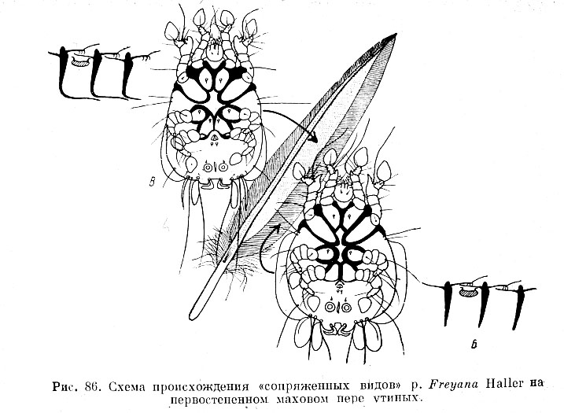
Different mites may inhabit different microhabitats, even on the same feather!
feather cross-section
mite
primary feather of a duck
feather barbs
tegmina
Freyana anatina
feather cross-section
mite
no tegmina
Freyana largifolia
feather barbs

Slide 8
Classification of the Psoroptidia
Sarcoptoidea
(mammals)
Pterolichoidea (birds)
Analgoidea (birds)
The “Psoroptidia”
The “Psoroptidia”
Unplaced: Lemanniellidae
Notes:
8

Slide 9
superfam. Pterolichoidea (mostly parasites non-passerine birds)
superfam. Analgoidea s.lat.(parasites of passerine birds and mammals)+house dust mites
Psoroptidia
Pterolichoidea
Analgoidea
house dust mites
Psoroptidia
(mostly parasitic taxa)

Slide 10
Psoroptidia phylogeny 1 (molecular data)

Slide 11
Psoroptidia phylogeny 2 (molecular data)
Mammal mites

Slide 12
Psoroptidia phylogeny 3 (molecular data)
Mammal mites

Slide 13
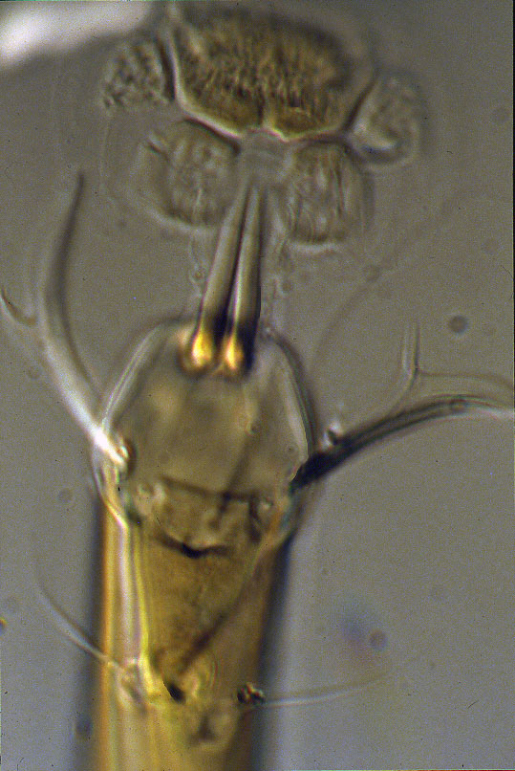
The superfamily Pterolichoidea
Characteristics:
1. Pretarsus without condylophore
guide
2. Condylophores usually
L-shaped
3. Proral setae usually present,
usually flattened & bifurcate
Habitats:
1. Vanes of pinnate feathers
(wing, tail)
2. Inside quills of flight feathers
& tail
3. Only 1 genus on plumose
feathers (Petitota, Kramerellidae)
Notes:
13

Slide 14
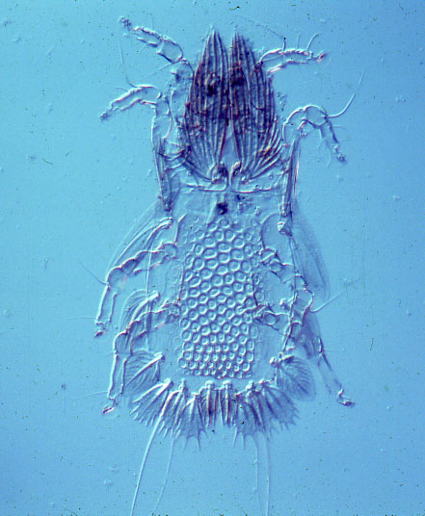
The superfamily Pterolichoidea
Hosts:
Common on most orders of
non-passerine birds.
Rare on the Passeriformes:
Gabuciniidae: Gabucinia on crows,
Vexillariidae: few Calaobia
on crows,
Ochrolichidae on African finches.
Opisthocomacarus umbellifer (Pterolichidae) from hoatzin
Notes:
14

Slide 15
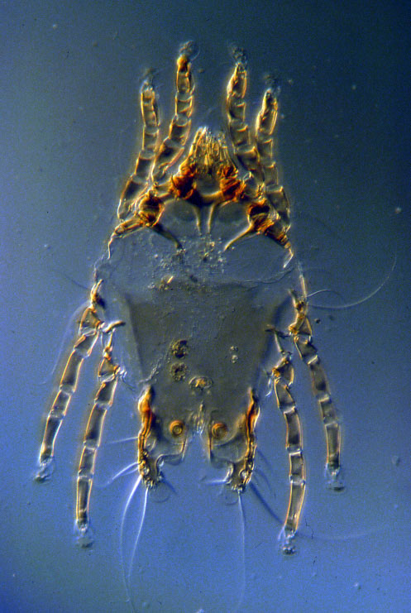
The superfamily Pterolichoidea
Classification:
18 families
Pterolichidae large, diverse,
possibly paraphyletic; on many
bird orders; especially diverse
on Galliformes, Psittaciformes.
e.g. Pterolichus obtusus on
domestic chicken
Pterygocrusolichus chanayi &
Contolichus latus on turkey
Pterolichus obtusus
(Pterolichidae) from chicken
Notes:
15

Slide 16
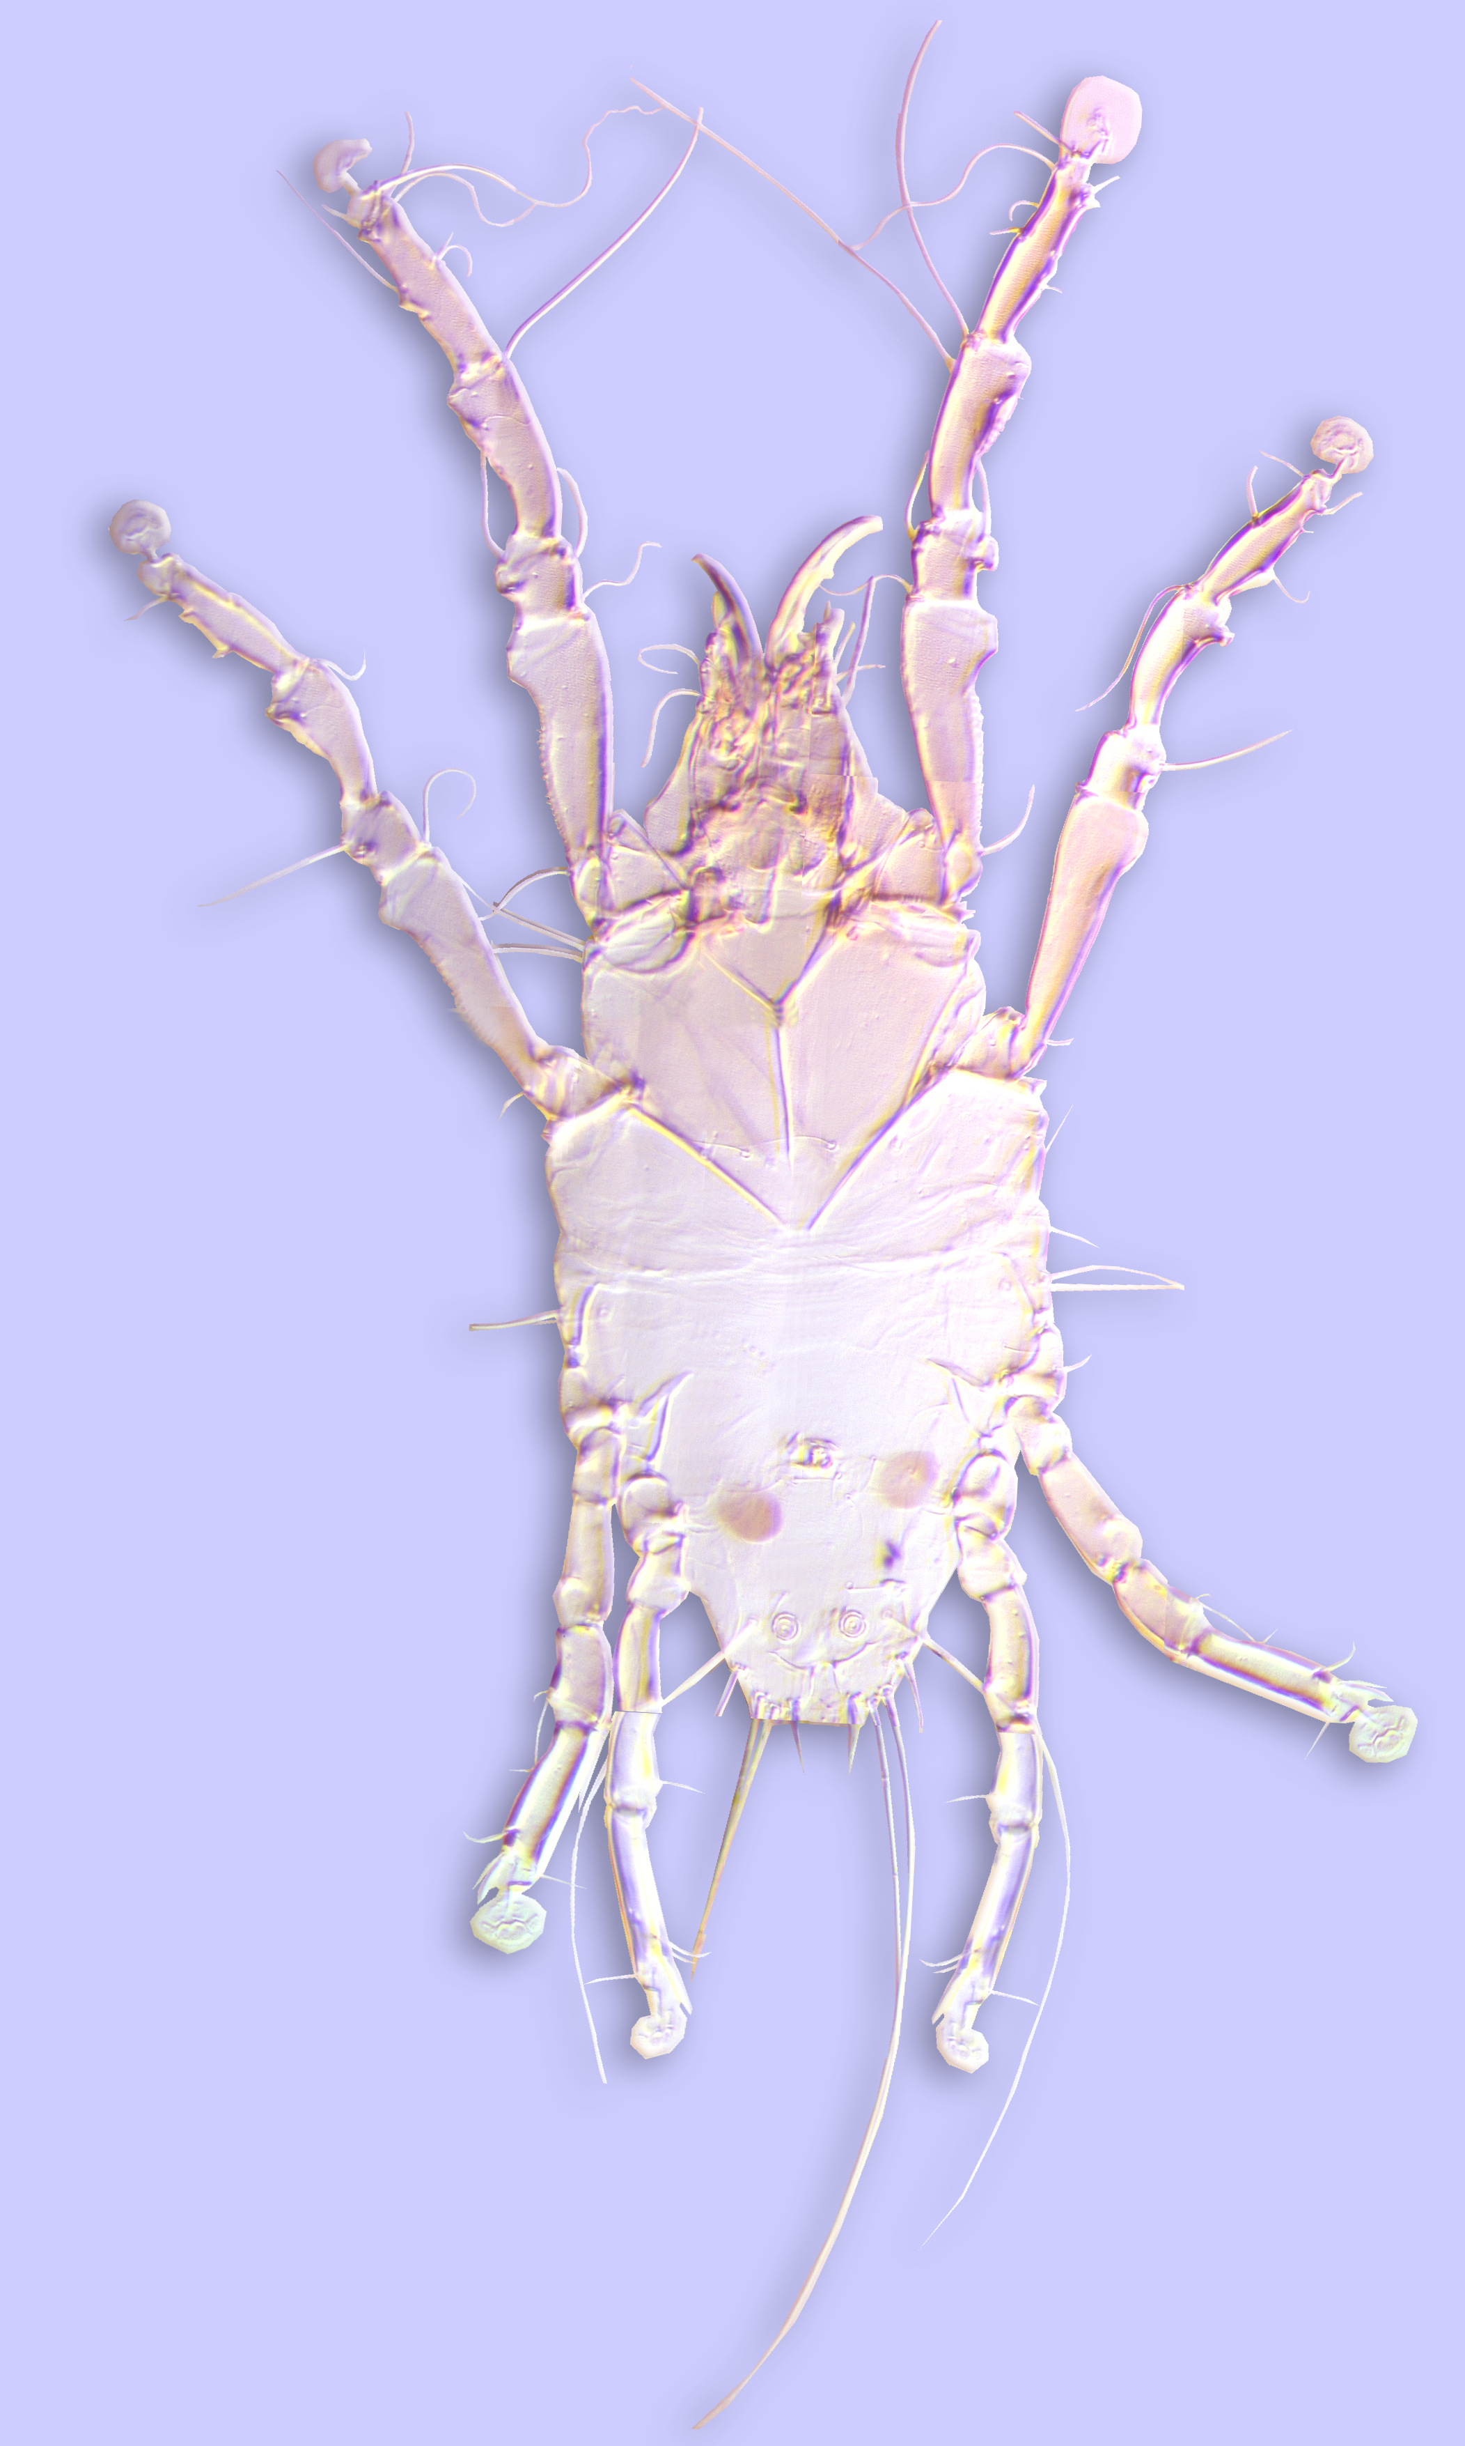
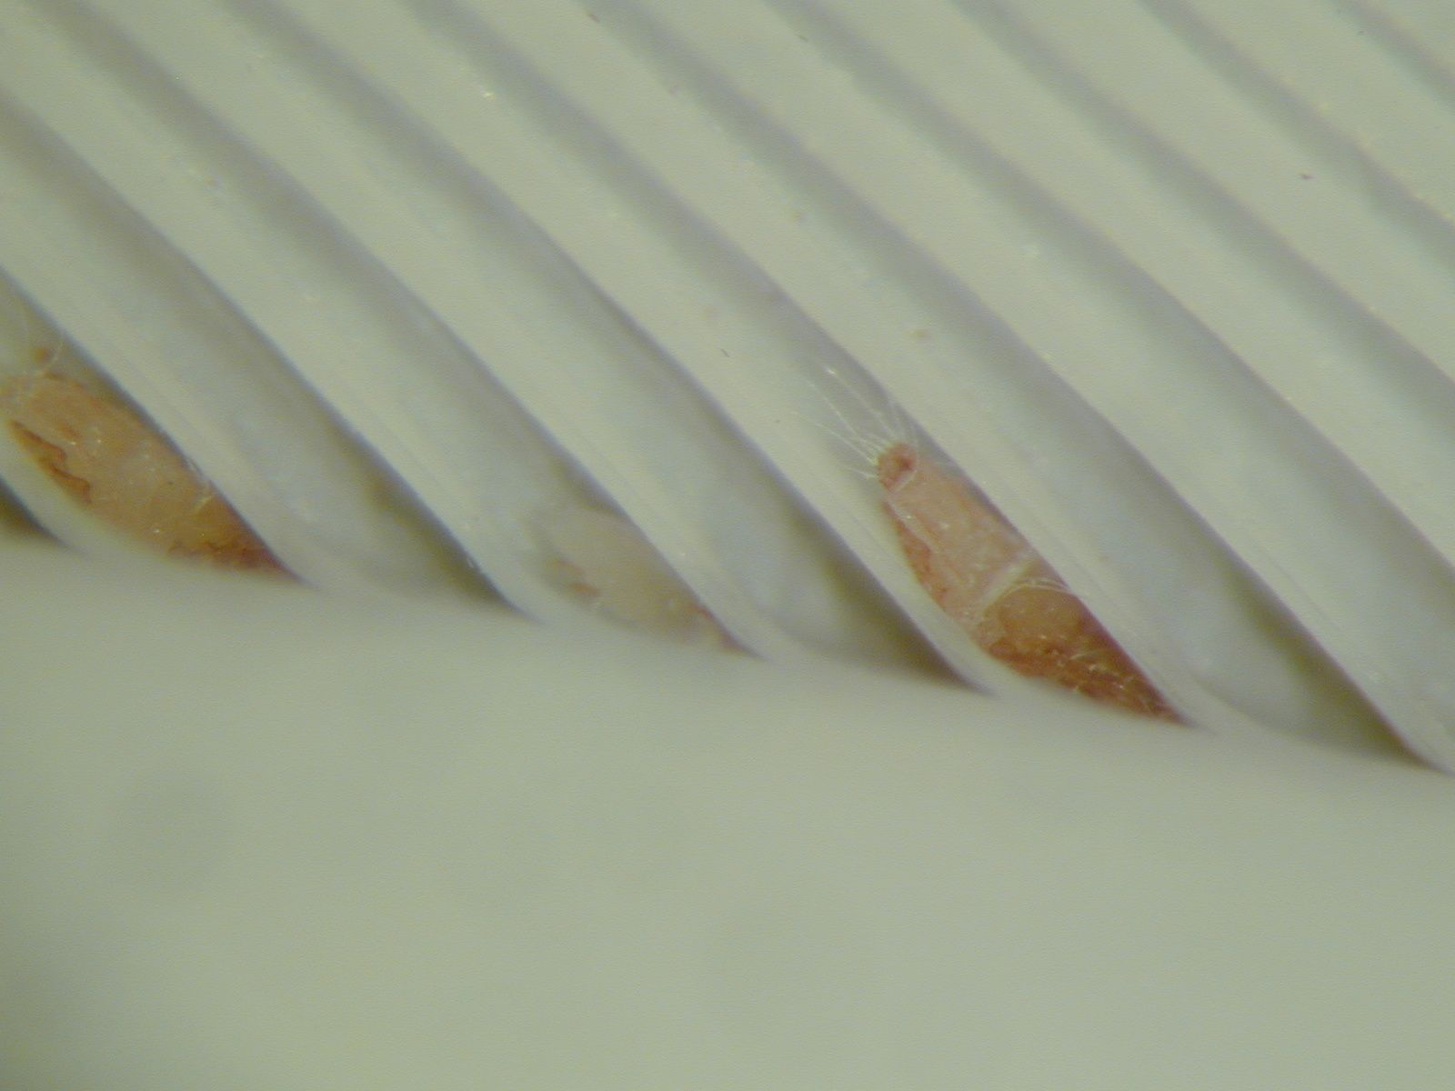
The superfamily Pterolichoidea
Classification: 18 families
Other families smaller, more
host restricted
Falculifer rostratus
(Falculiferidae) from domestic pigeon
Faculiferidae
Notes:
16

Slide 17
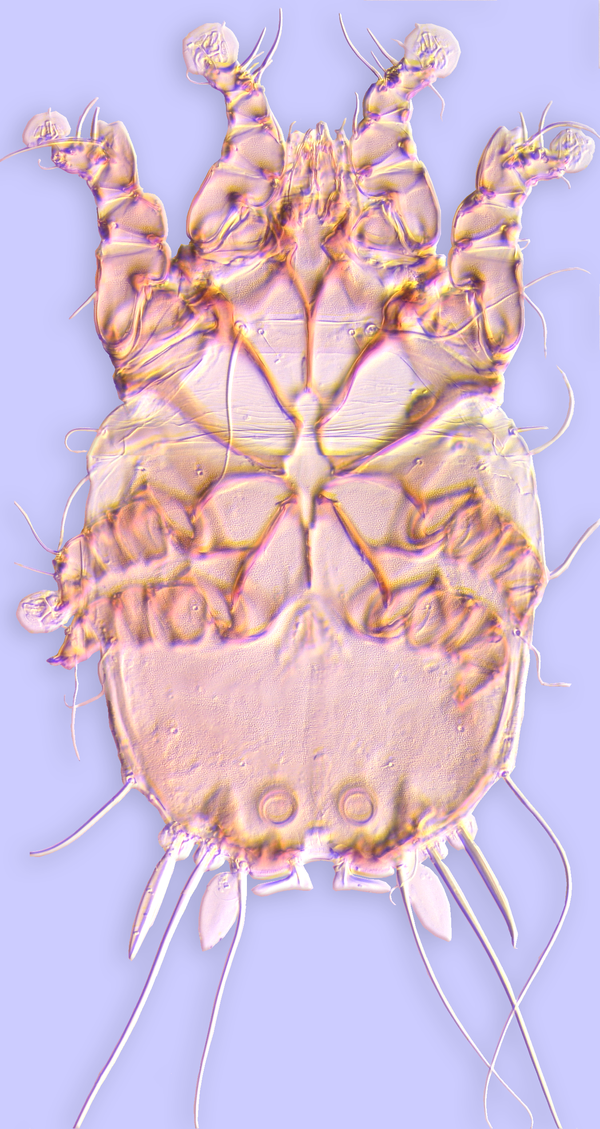
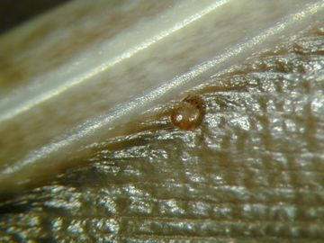
The superfamily Pterolichoidea
Classification: 18 families
Other families smaller, more
host restricted
Freyana sp. (Freyanidae) from common merganser
Freyana (Freyanidae)
Notes:
17

Slide 18
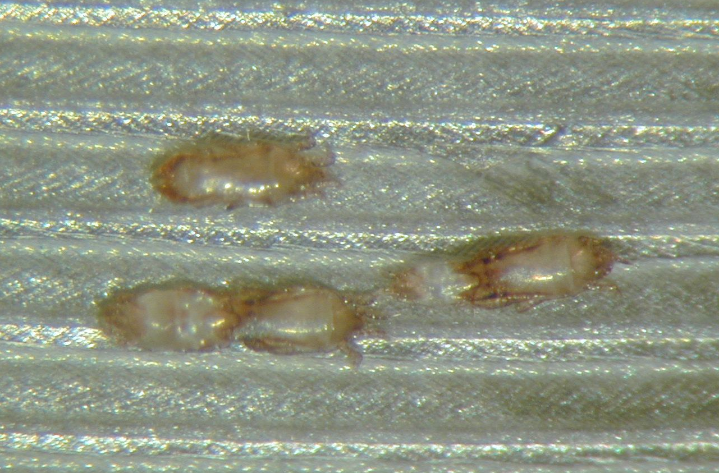
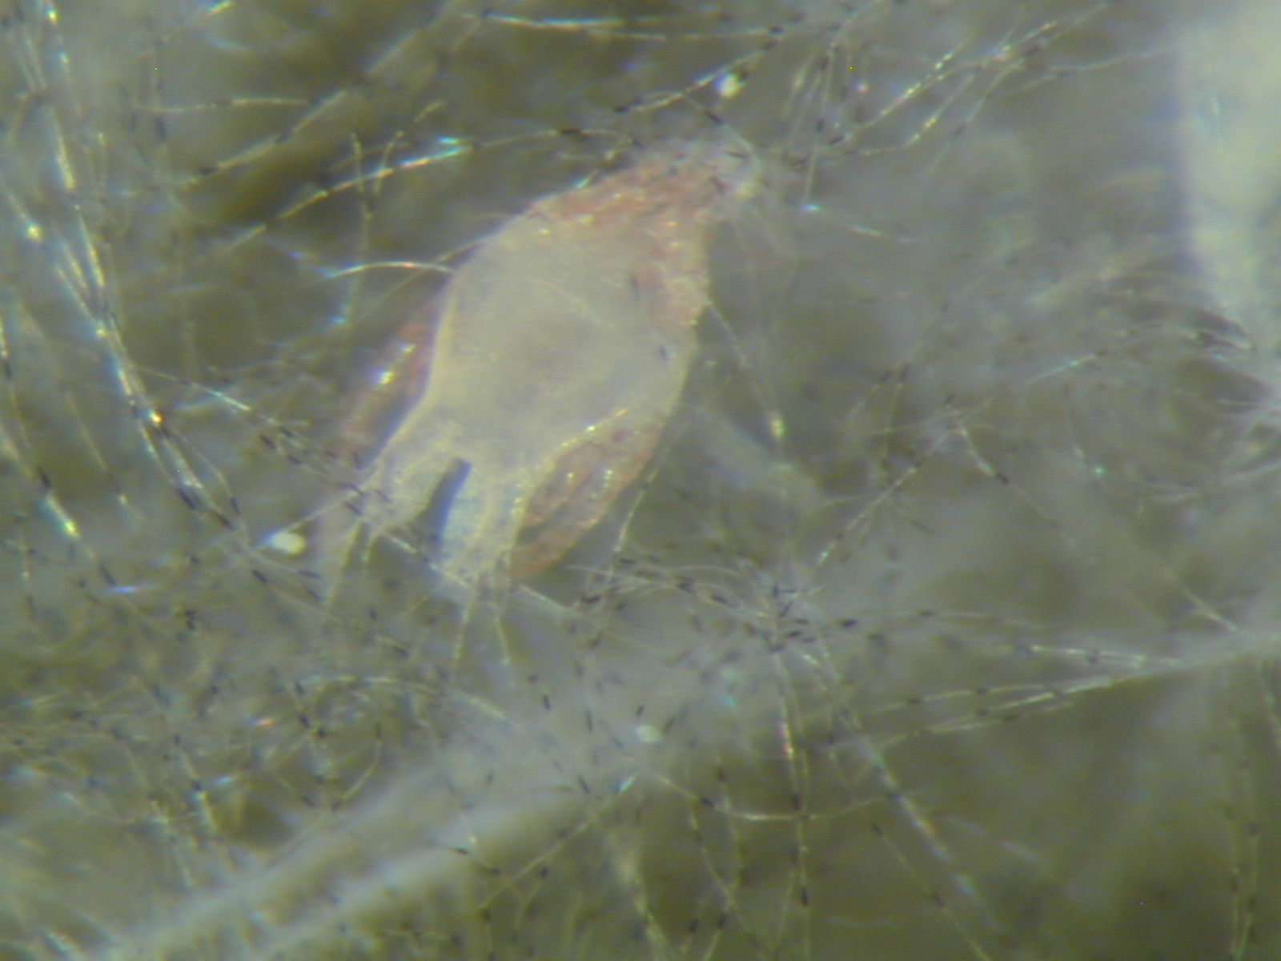
The superfamily Pterolichoidea
Classification: 18 families
Other families smaller, more
host restricted
Ptiloxenus major
(Ptiloxenidae) from grebe
Petiota bubonis
(Kramerellidae) from great horned
owl
Notes:
18

Slide 19
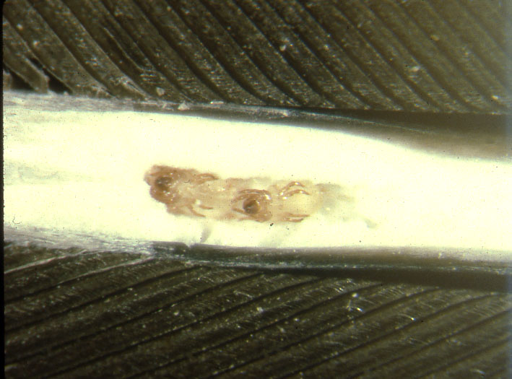
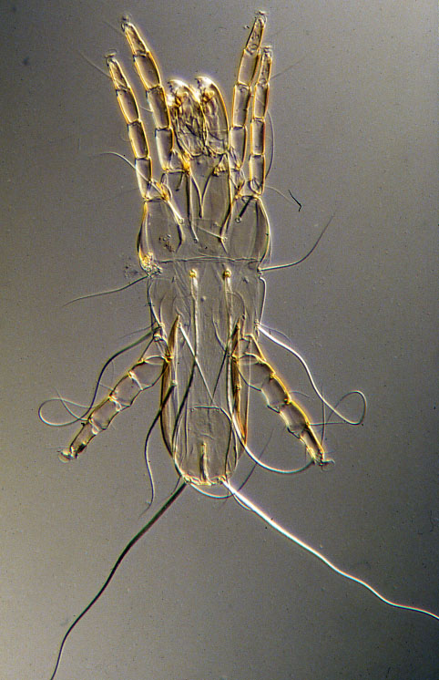
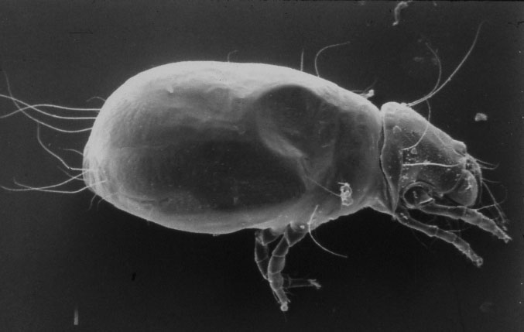
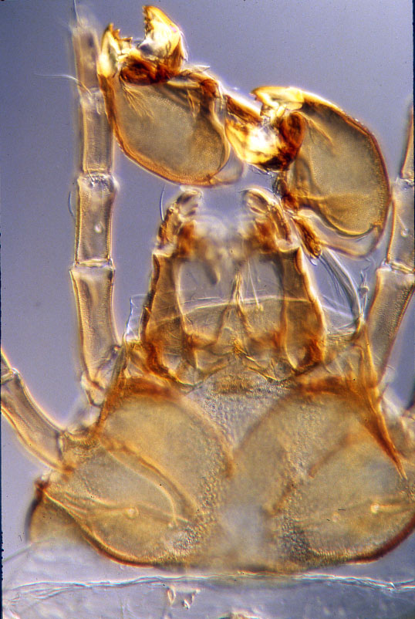
The superfamily Pterolichoidea
Classification: 4 families live within feather quills
Ascouracaridae on many
bird orders
May consume entire feather medulla
female
male
Cystidosoma anacrotricha (Ascouracaridae) from African gray parrot
Cystoidosoma sp. female
(Ascouracaridae) from parrot
larva (dispersing stage)
Notes:
19

Slide 20
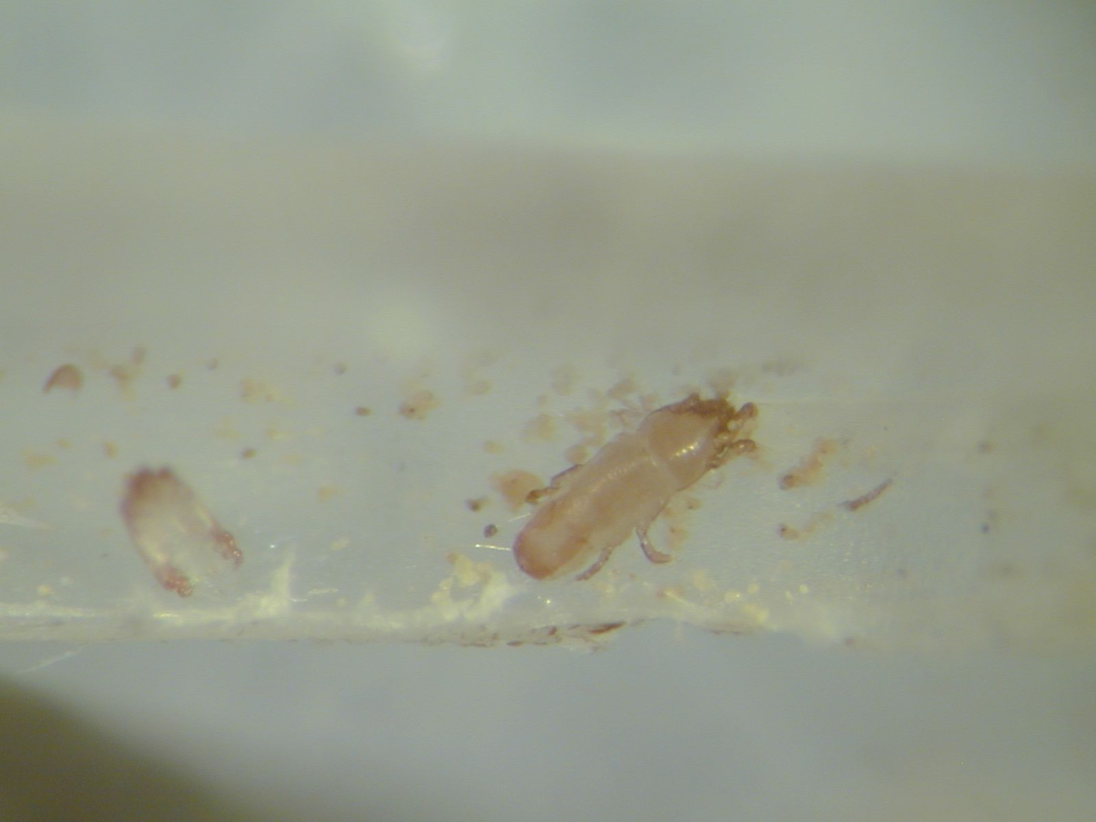
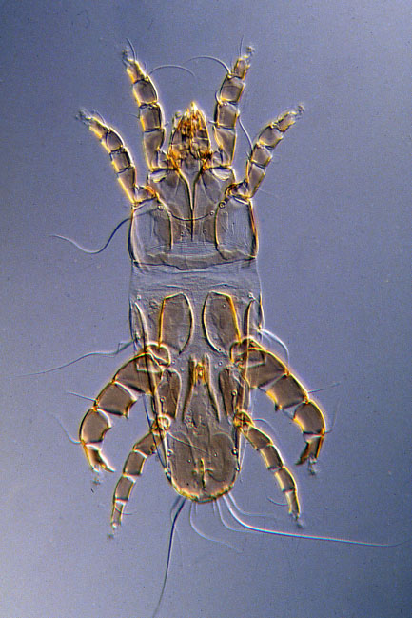
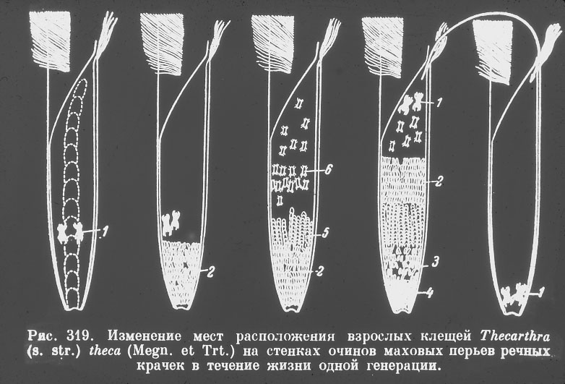
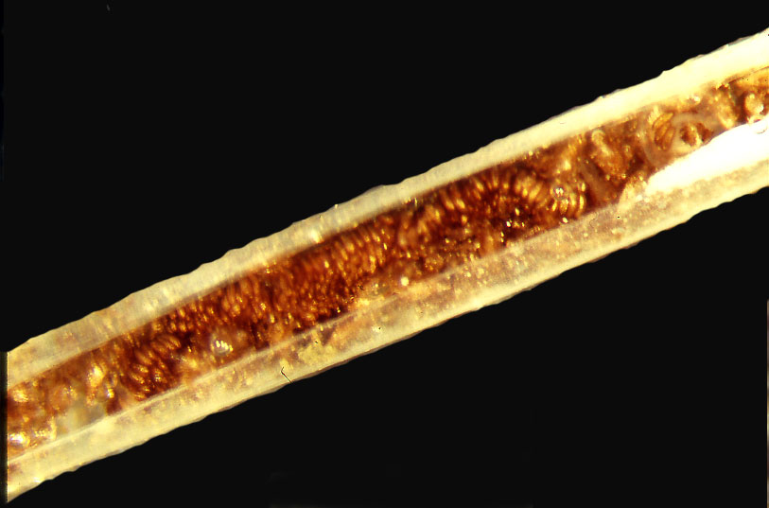
The superfamily Pterolichoidea
Classification: 4 families live within feather quills
Syringobiidae on Charadriiformes
Feed on keratinaceous material, with most feeding on pulp caps in the
lower part of the feather.Plutarchusia and Paidoplutarchusia, consume the pithy feather medulla and can cause considerable damage.
Phyllochaeta tenuiseta
(Syringobiidae) from killdeer
Some species deposit eggs in designated “nursery” quill
damage to quill
Sikyonemus minutillae (Syringobiidae) from least sandpiper
Notes:
20

Slide 21
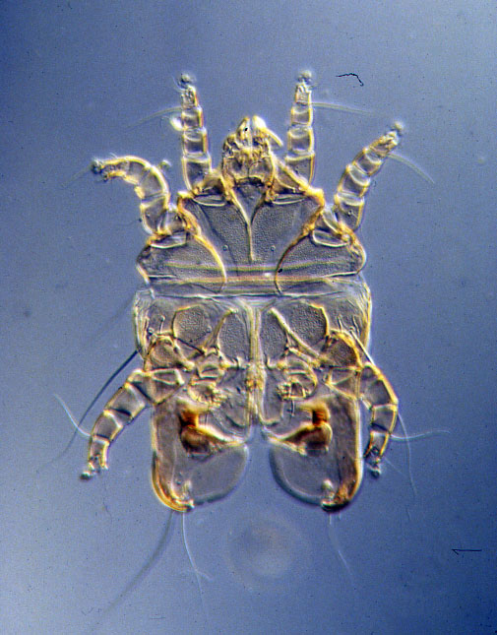
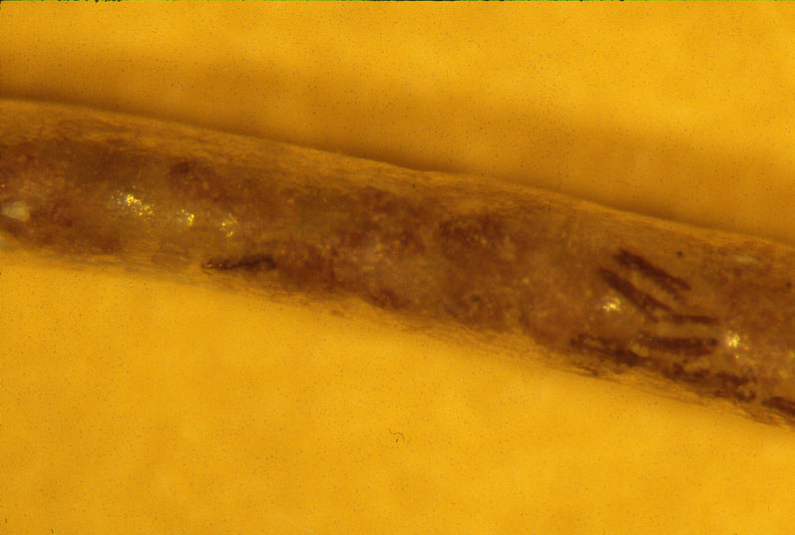
The superfamily Pterolichoidea
Classification: 4 families live within feather quills
Kiwilichidae on Apterygiformes
two dorsal sclerites
Kiwilichus sp.
(Kiwilichidae) from kiwi
Kiwilichus sp.
in vestigial wing feather of kiwi
Notes:
21

Slide 22
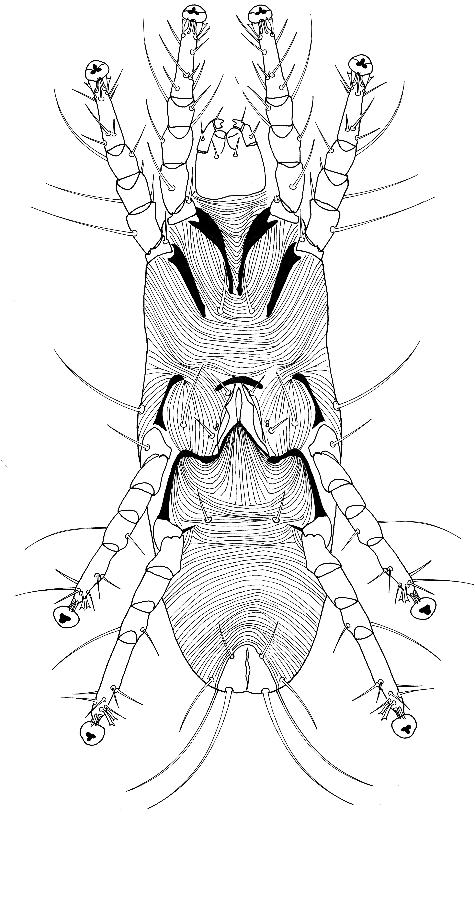
The superfamily Pterolichoidea
Classification: 4 families live within feather quills
Oconnoriidae on Strigiformes
Oconnoria inexpectata
(Oconnoriidae) from Philippine owl
Notes:
22

Slide 23
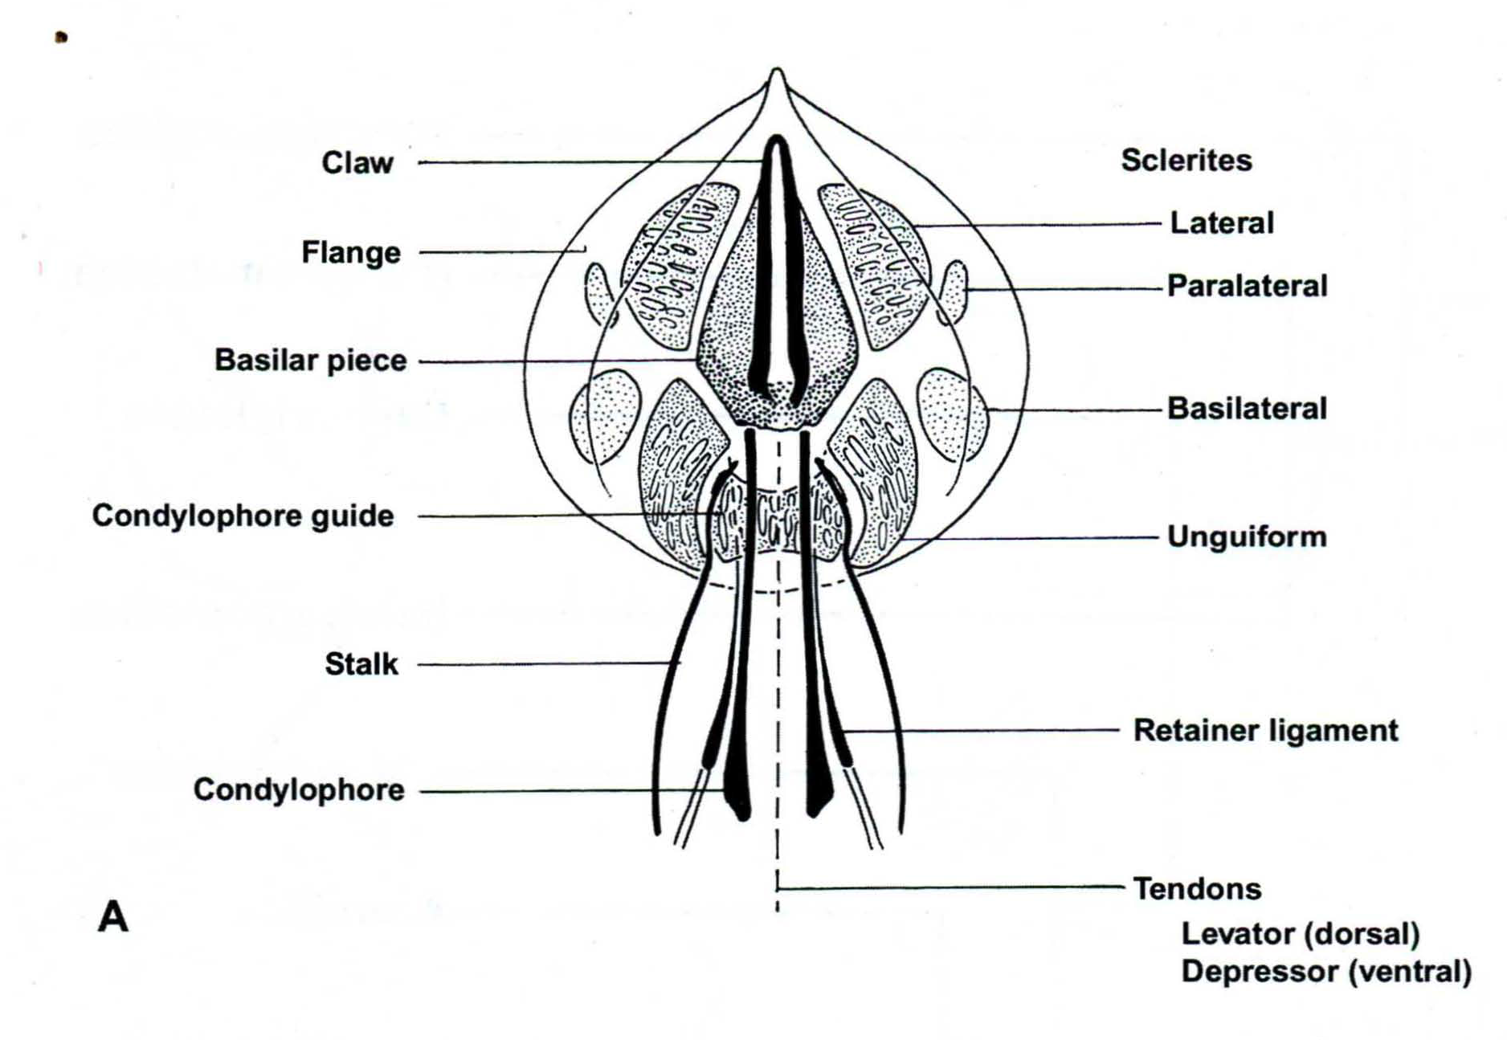
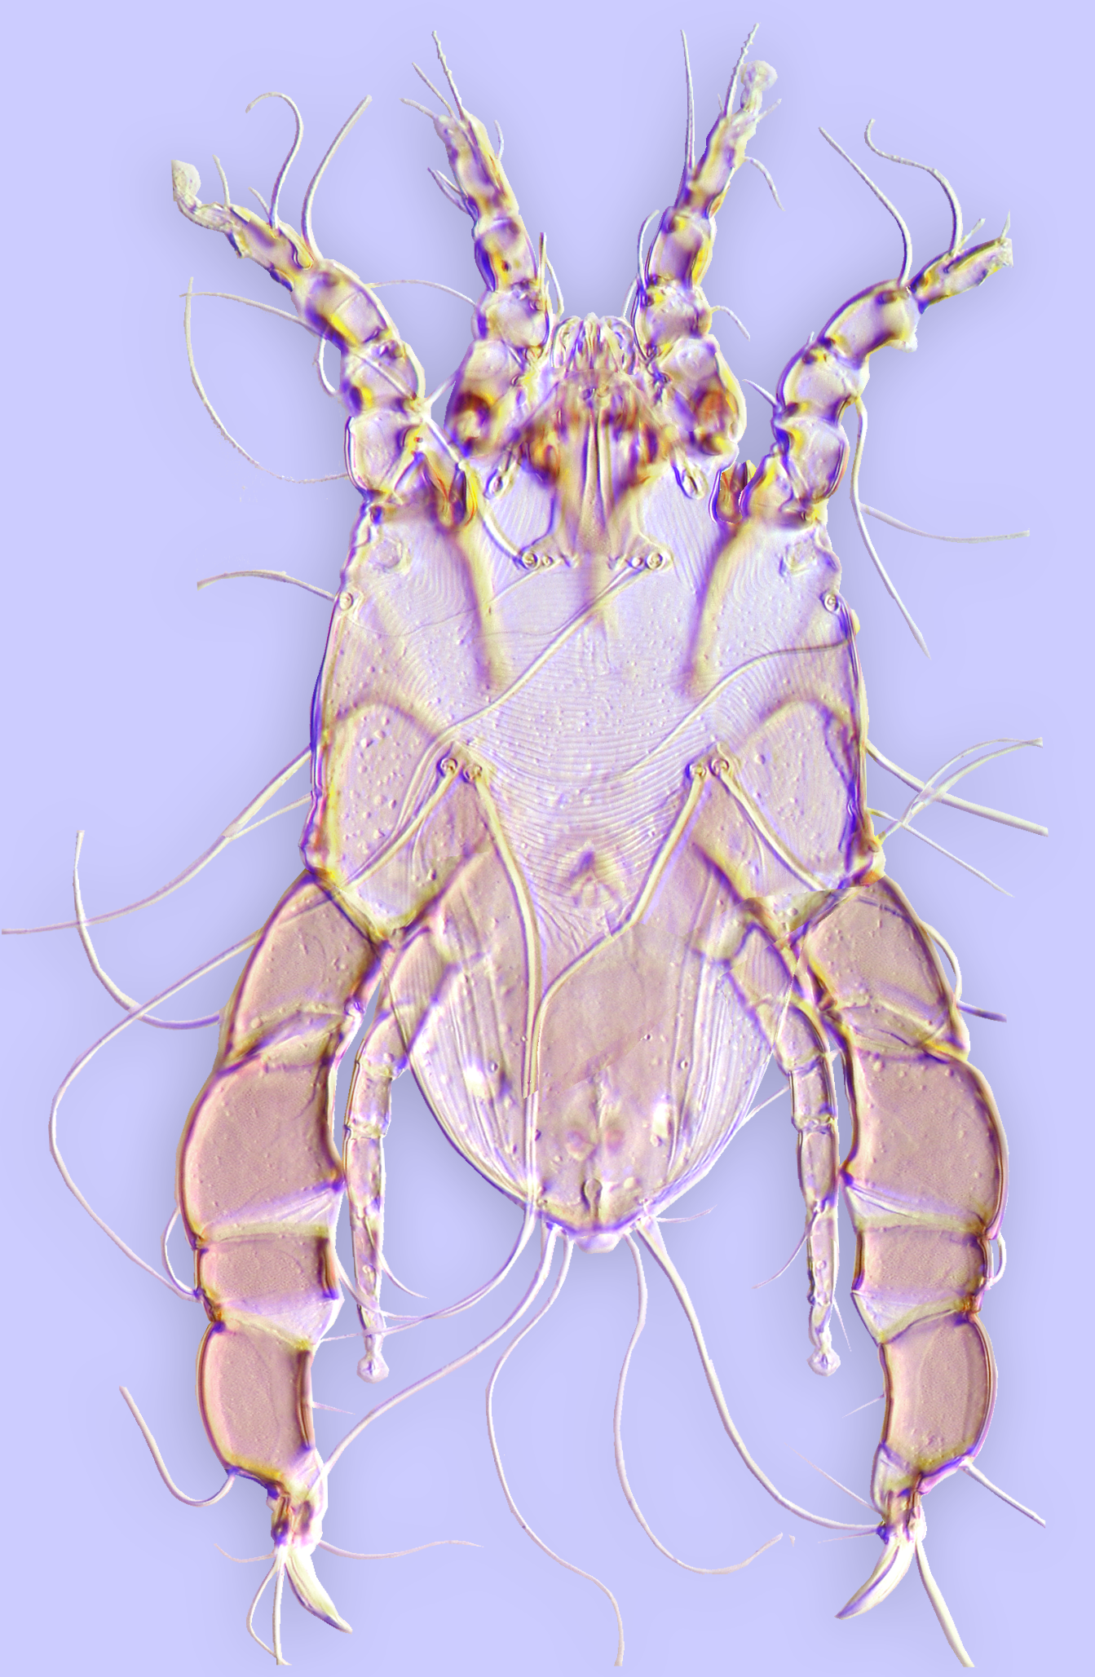
The superfamily Analgoidea
Classification:
19 families – may occur on all
bird orders.
Ecological diversity much
greater than Pterolichoidea.
Characteristics:
Pretarsi w/condylophore guide
Proral setae absent
Condylophores straight, often with basal branches
Analges (Analgidae)
Notes:
23

Slide 24
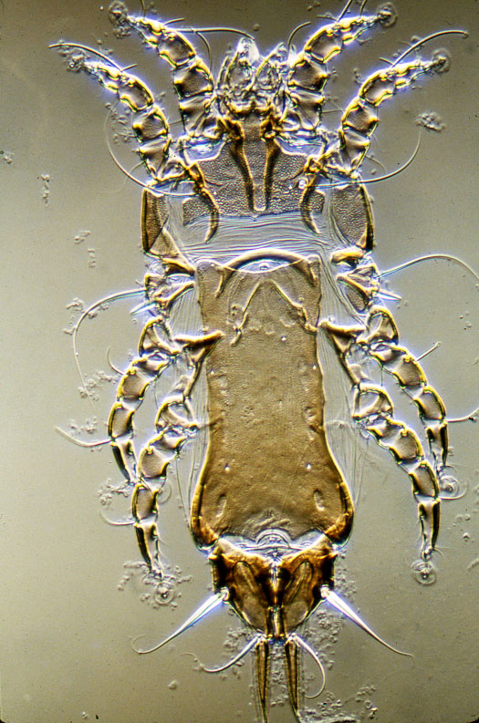
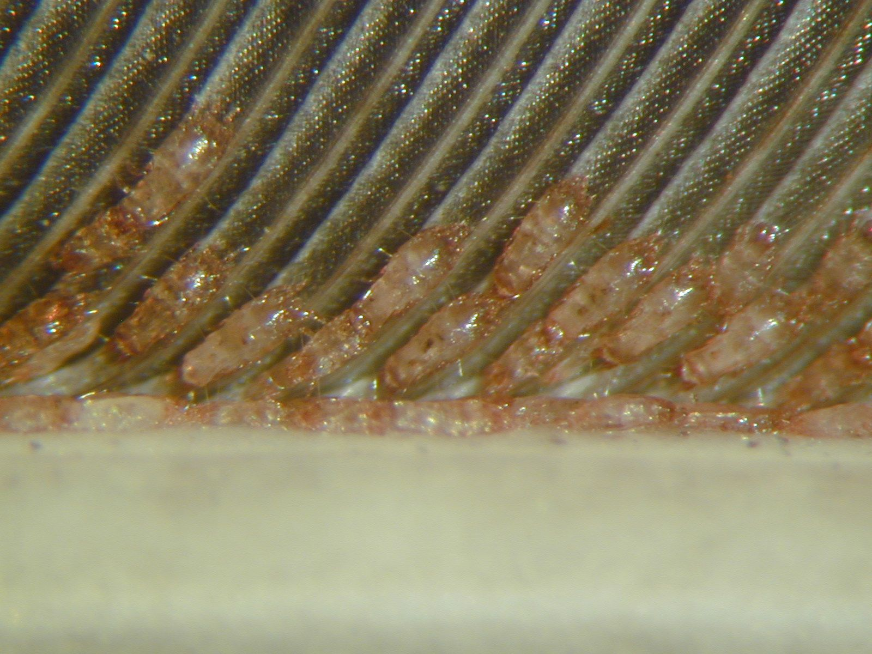
The superfamily Analgoidea
Classification:
6 families live on pinnate feather vanes
1. Family Proctophyllodidae
most diverse on Passeriformes and
Trochilidae (Apodiformes)
(hummingbirds), rare on other groups.
Most with terminal processes in female,
some with leaf-like lamellae in male.
Proctophyllodes pheuctici
(Proctophyllodidae) from
Rose-breasted grosbeak
Proctophyllodes glandarinus
(Proctophyllodidae) from
European jay
Notes:
24

Slide 25
Analgoidea living on feather vanes
female
terminal processes
Proctophyllodes ampelidis on bird Bombycilla cedrorum.

Slide 26
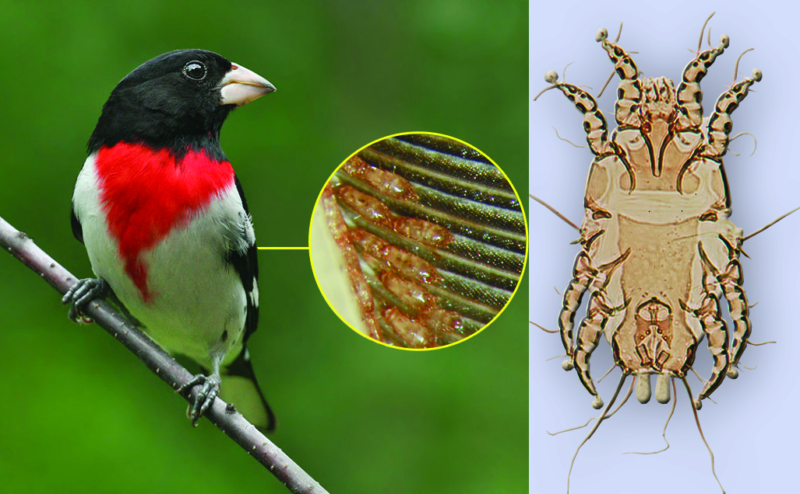
Analgoidea living on feather vanes
male
leaf-like lamellae
Proctophyllodes pheuctici on bird Pheucticus ludovicianus.

Slide 27
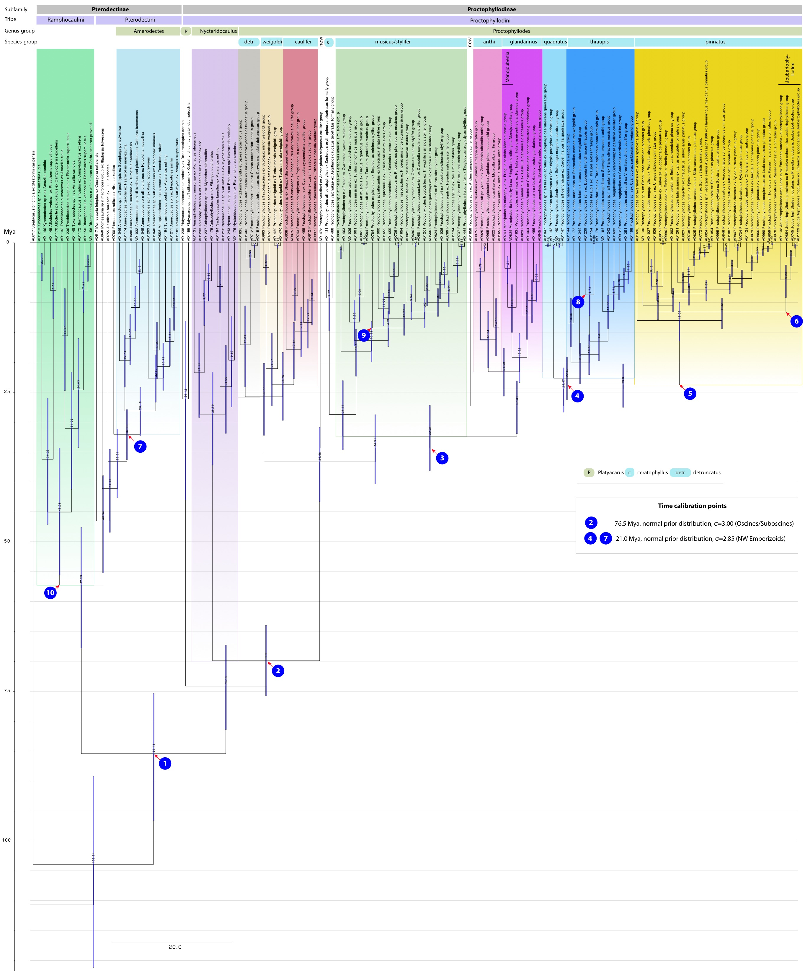
Molecular phylogeny of Proctophyllodidae

Slide 28
Co-dispersal and co-phylogeny (Proctophyllodidae and passerine hosts)

Slide 29
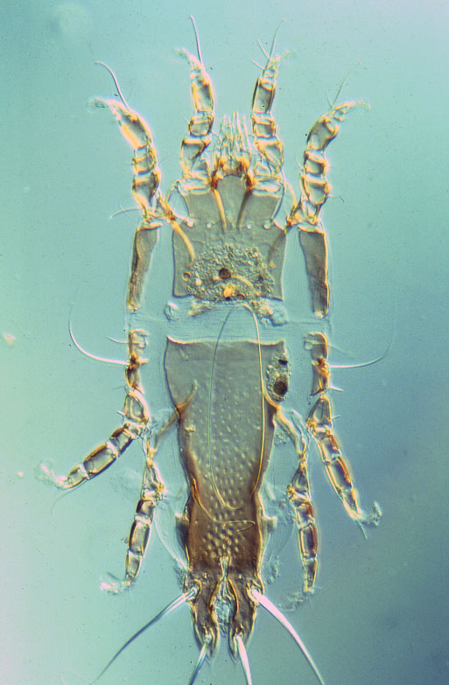
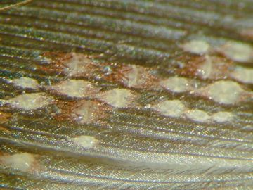
The superfamily Analgoidea
Classification:
6 families live on feather vanes
2. Family Trouessartiidae
Diverse on Passeriformes and
some other orders.
Femur-genu fused on legs III-IV.
Typically live on dorsal surface
of wings, upper coverts & head.
femur-genu III-IV fused
Calcealges n. sp. (Trouessartiidae) from kinglet.
Trouessartia rosterii(Trouessartiidae) from common starling
Notes:
29

Slide 30
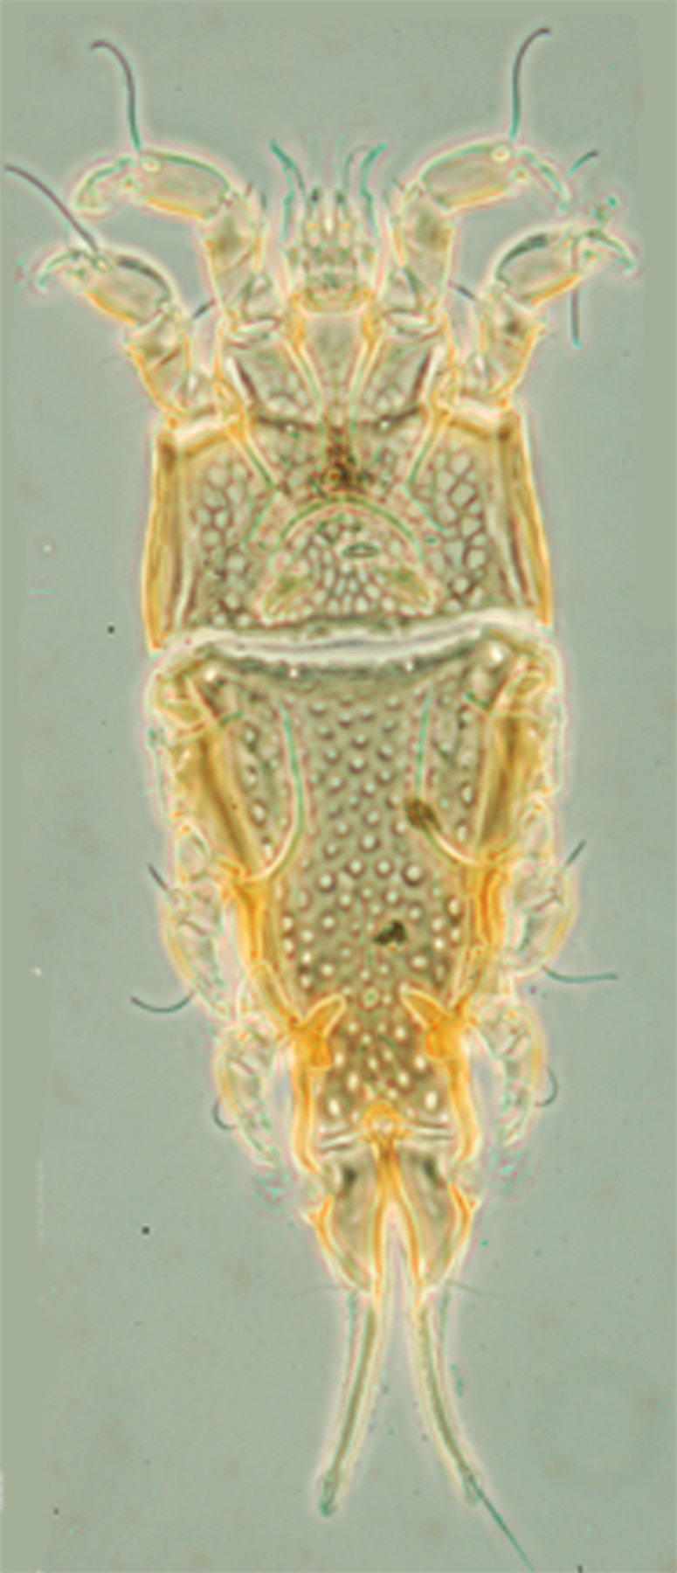
The superfamily Analgoidea
Classification:
6 families live on feather vanes
3. Family Thysanocercidae
Similar to Trouessartiidae but
femur-genu fused on all legs.
Live on wing & tail feathers of
Apodidae (swifts).
femur-genu
I-IV fused
Notes:
30

Slide 31
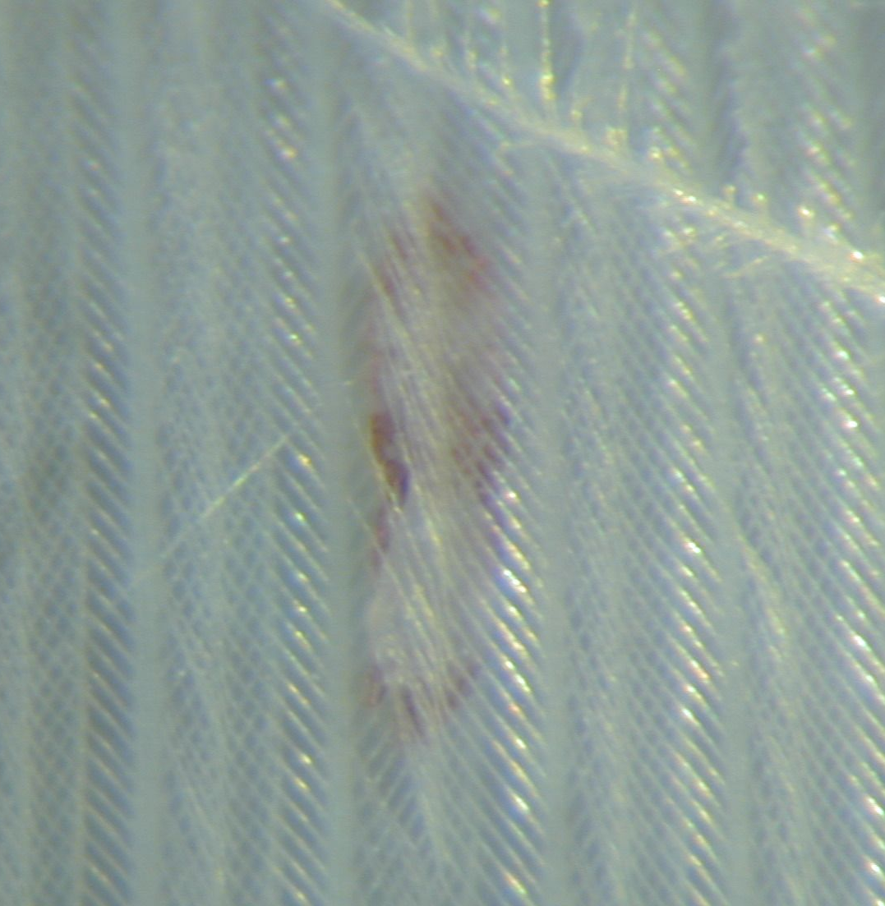
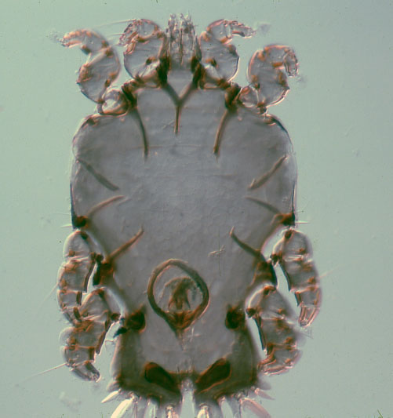
The superfamily Analgoidea
Classification:
6 families live on feather vanes
4. Family Alloptidae
Diverse on aquatic bird orders.
Femur-genu fused on all legs.
Alloptes calidridis (Alloptidae) from sandpiper
Echinacarus sp.
(Alloptidae) from
albatross
Notes:
31

Slide 32
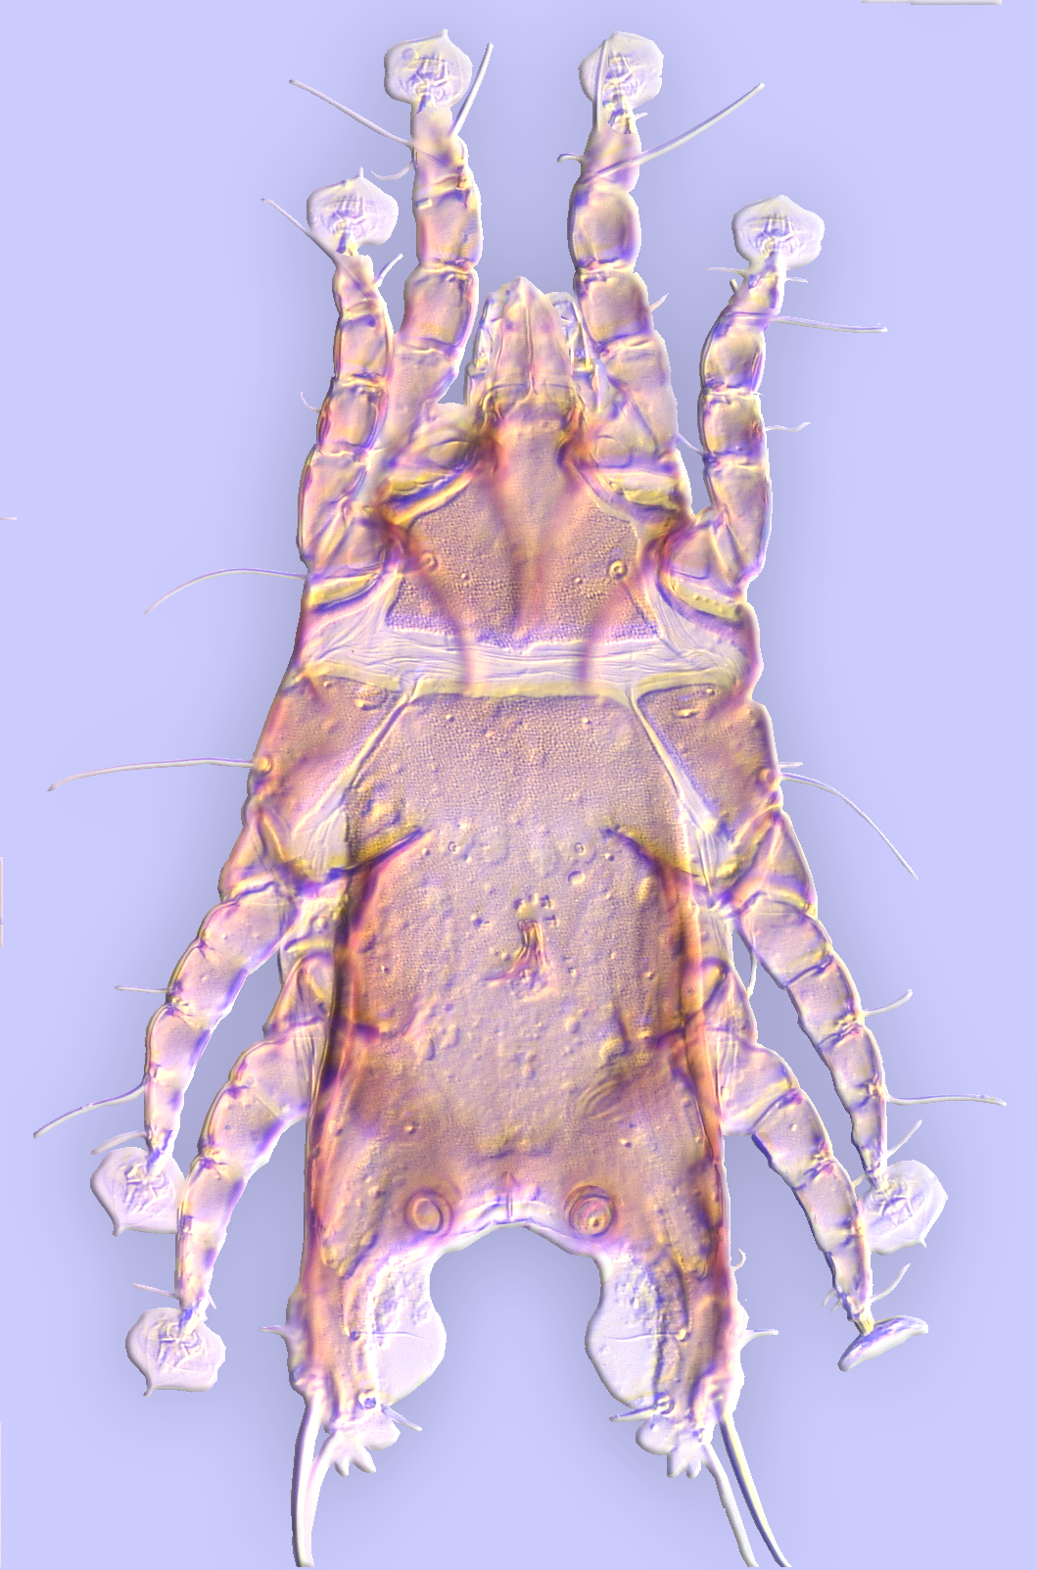
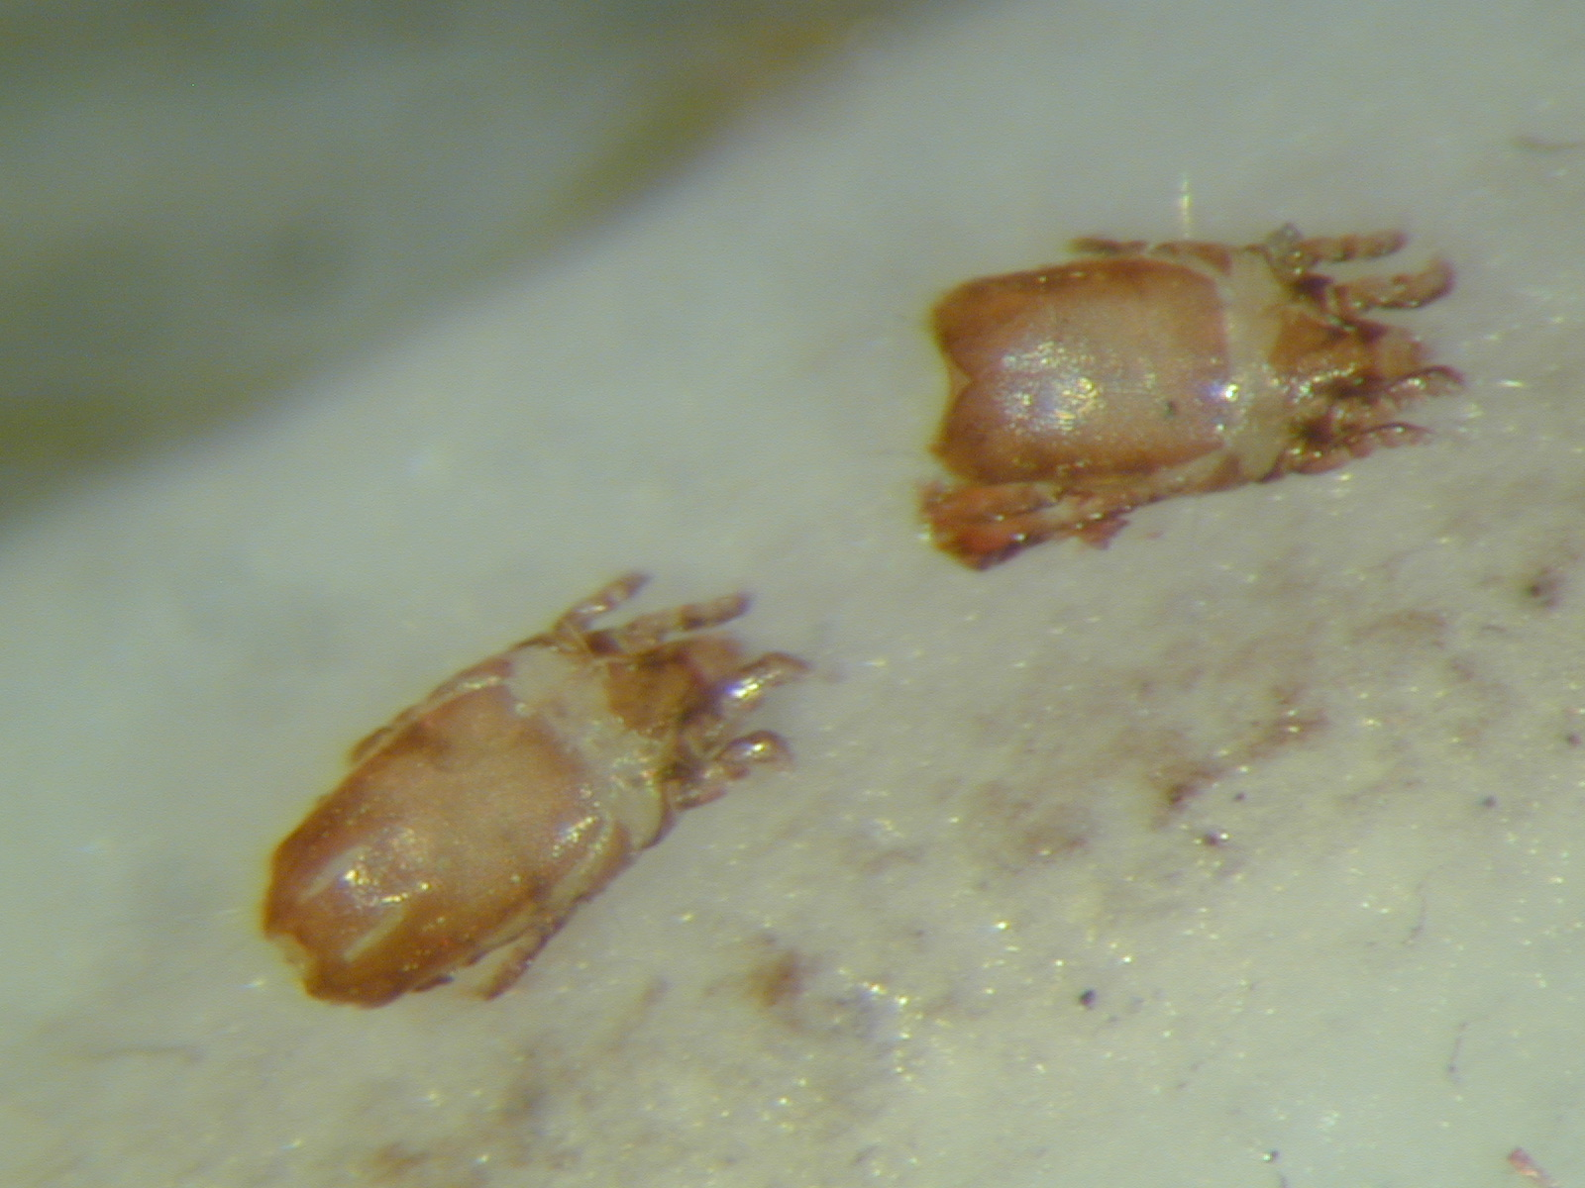
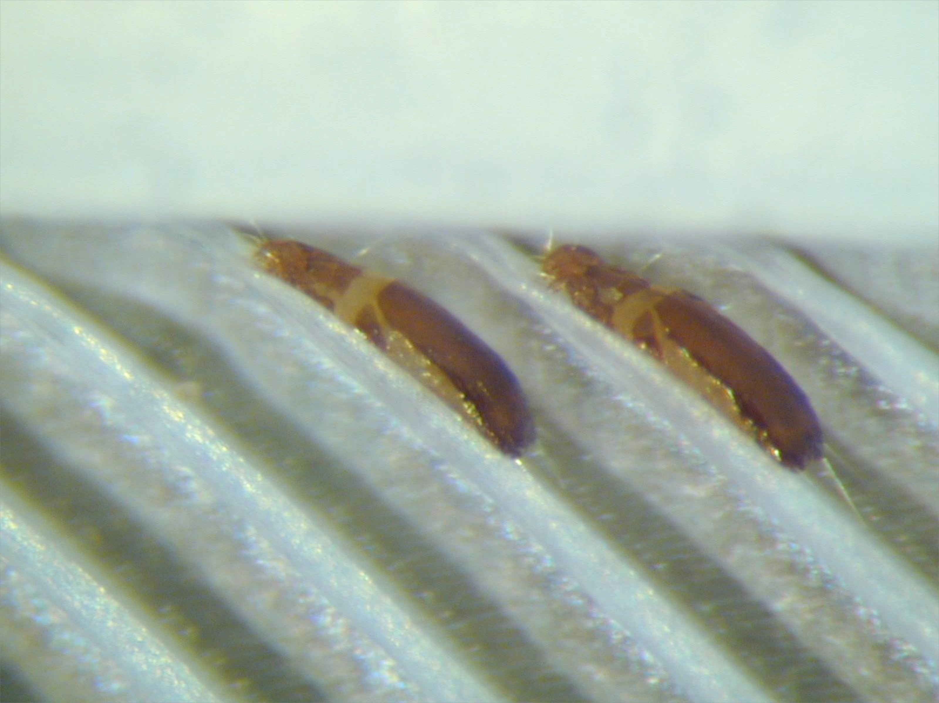
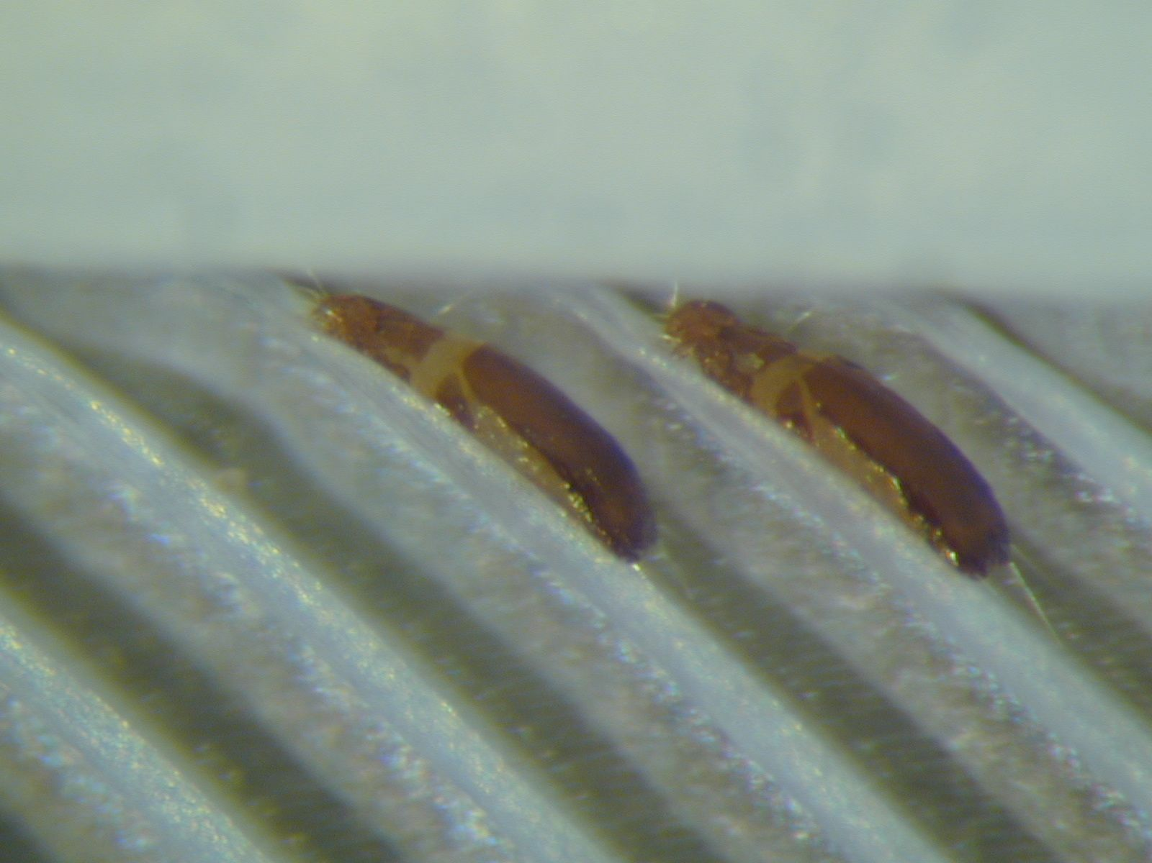
The superfamily Analgoidea
Classification:
6 families live on feather vanes
5. Family Avenzoariidae
Early derivative analgoid lineage.
Diverse on aquatic bird orders.
Ambulacral disc narrowed apically
Like “ace of spades”.
“ace of spades”
Bychovskiata squatarolae
(Avenzoariidae)
from plover
Avenzoaria calidridis
(Avenzoariidae) from least sandpiper.
Avenozoaria
(Avenzoariidae)
Avenzoaria calidridis
(Avenzoariidae)
from least sandpiper.
Notes:
32

Slide 33


The superfamily Analgoidea
Classification:
6 families live on feather vanes
6. Family Pteronyssidae
Diverse on Passeriformes &
Piciformes.
Ambulacral disc narrowed apically
like “ace of spades”, some setal
differences with Avenzoariidae.
Neopteronyssus pici
from downy woodpecker
Pteronyssus picoides
(Pteronyssidae)
from hairy woodpecker.
Notes:
33

Slide 34


The superfamily Analgoidea
Classification:
3 families live on plumaceous
feathers
1. Family Analgidae
Diverse on many bird orders.
Ambulacral stalk originates ventrally.
Spines or membranes on anterior
tibiae. Males often with continuous,
size-related polymorphism
Analges (Analgidae)
Analges (Analgidae)
Analges sp.
(Analgidae)
from waxwing.
Notes:
34

Slide 35



The superfamily Analgoidea
Classification: 3 families live on plumaceous feathers
2. Family Psoroptoididae
Diverse on many bird orders.
Ambulacral stalk originates apically. No membranes on anterior
tibiae. Males not polymorphic.
(sometimes can be found on
vanes)
One genus, Allopsoroptoides, host shifted to domestic chicken and mange in commercial poultry facilities.
Picalgoides sp.
from hairy woodpecker.
Mesalgoides sp.
(Psoroptoididae)
from catbird.
Notes:
35

Slide 36



The superfamily Analgoidea
Classification:
3 families live on plumaceous
feathers
3. Family Xolalgidae
Diverse on many bird orders.
Femur-genu fused on legs I-II.
Tibiae I-II often with apophyses.
Males with enlarged legs
III or IV.
femur-genu I-II fused
Ingrassia sp. (Xolalgidae) male
Ingrassia sp. (Xolalgidae) from sandpiper.
Ingrassiella sp. (Xolalgidae) from chipping sparrow.
Notes:
36

Slide 37



Coevolution facilitates pre-copulatory guarding
Male with
chelate legs
IV
Female
nymphs with
hind legs
reduced
Xolalgoides n. sp.
ex Ploceus sakalava
Madagascar

Slide 38


The superfamily Analgoidea
Classification:
4 families live exclusively within
quills, some species in 3 others
do as well.
1. Family Dermoglyphidae
Occur on several bird orders.
Ambulacral stalks as in Analgidae.
May feed on keratin or blood from
inferior umbilicus. Species in tinamous form
separate lineage.
Paralges sp.
(Dermoglyphidae from parrot
Dermoglyphus sp. damage in duck quill
Notes:
38

Slide 39

The superfamily Analgoidea
Classification: 4 families live exclusively within quills, some species in 3 others do as well.
2. Family Gaudoglyphidae: 1 species, G. minor, in chickens
tritonymph has regressed mouthparts and posterior legs
Notes:
39

Slide 40


The superfamily Analgoidea
Classification: 4 families live exclusively within quills, some species in 3 others
do as well.
3. Family Apionacaridae
Occur on charadriiform, galliform, and passeriform birds.
Globose body, highly neotenous. Male may lack legs IV. Always occur with Syringophilidae.
The larvae are elongate and serve as
the dispersing stage.
quill opened
Atelespoda sp. (Apionacaridae) from Baltimore oriole
Apionacarus sp. from snipe.
Notes:
40

Slide 41

The superfamily Analgoidea
Classification:
4 families live exclusively within
quills, some species in 3 others
do as well.
4. Family “Ptyssalgidae”
Occur in Trochilidae (hummingbirds)
& an undescribed genus has been
collected from Neotropical flycatchers.
Omega-1 solenidion on tarsi I-II
apical. Molecular evidence suggests
derivation from Pteronyssidae.
Ptyssalges sp. (Ptyssalgidae) from hummingbird.
Notes:
41

Slide 42


The superfamily Analgoidea
Classification: 4 families live exclusively within quills, some species in 3 others do as well.
Some Proctophyllodidae also live
in hummingbird quills, either to
molt & oviposit, or permanently.
superior umbelicus enlarged by mite
mite posterior body
Rhamphocaulus sp (Proctophyllodidae) from hummingbird.
quill
Notes:
42

Slide 43


Family “Pyroglyphidae”
Molecular and morphological evidence
suggests the genus Paralgopsis, living
inside parrot quills, belongs to the
Psoroptoididae. Feed on keratinaceous pulp caps
Paralgopsis sp.
from Orange-winged
Amazon.

Slide 44
Psoroptidia phylogeny 2 (molecular data)
Mammal mites

Slide 45
Psoroptidia phylogeny 3 (molecular data)
Mammal mites

Slide 46


The superfamily Analgoidea
Classification:2 families live on the skin and in feather follicles.
1. The Epidermoptidae occur on
numerous bird orders in skin lesions
& feather follicles. Can cause “mange”.
Anterior tarsi short, with hook on tarsus.
Microlichus americanus
(Epidermoptidae)
from Baltimore oriole.
female mite
mite egg
Notes:
46

Slide 47

The superfamily Analgoidea
Classification:
2 families live on the skin and in
feather follicles.
1. The Epidermoptidae
Epidermoptes bilobatus is a parasite
of domestic chickens. It is rarely
reported today. Older reports
indicate the mite causes a
“mange-like” condition.
Notes:
47

Slide 48

The superfamily Analgoidea
Classification:
2 families live on the skin and in
feather follicles.
The Epidermoptidae has recently been expanded to include
species formerly placed in a separate family Knemidokoptidae.
However, molecular data suggest a relationship of these
mites with the Dermationidae.
These mites live in feather follicles or burrow
into tissues of their hosts, which are known
in several bird orders. These species are
globose, with very short legs and paired
prodorsal apodemes.
paired prodorsal apodemes
Knemidokoptes jamaicensis
(Epidermoptidae)
from songbird.
Notes:
48

Slide 49


The superfamily Analgoidea
Classification:
2 families live on the skin and in
feather follicles.
Knemidokoptes mutans in chickens and K. jamaicensis in
passerine birds cause serious deformation of the legs & feet,
a condition known as “scaly-leg.”
Knemidokoptes jamaicensis
(Epidermoptidae)
from yellow warbler.
Notes:
49

Slide 50
Analgoidea living on skin and in the feather follicles
Species of Knemidocoptinae live in subcutaneous tissue, displaying ecological paralellism with Sarcoptidae, the family of mammalian parasites.
.
damage
Knemidocoptes (Knemidocoptidae)
Knemidokoptes from the rook (Corvus frugilegus)

Slide 51


Analgoidea living on skin and in the feather follicles
Knemidokoptes mutans scaly-leg in chicken.
Knemidokoptes pilae damage to beak and cere in parakeet.
Notes:
51

Slide 52
The superfamily Analgoidea
Classification:
2 families live on the skin and in
feather follicles.
Knemidokoptidae
Species of Neocnemidocoptes
live in feather follicles and
can cause “depluming” or
feather plucking. N. gallinae
occurs in galliform birds including
domestic poultry and N. levis
occurs in pigeons.
Damage on chicken
Notes:
52

Slide 53
Analgoidea living on skin and in the feather follicles
.
Heterosporus (Heterosporidae)

Slide 54


The superfamily Analgoidea
Classification:
2 families live on the skin and in
feather follicles.
Species of Myialges and Promyialges
are hyperparasites of Hippoboscidae
as adult females. Species have broad
host ranges for both birds & flies.
Myialges sp. on hippoboscid
mites
Notes:
54

Slide 55

The superfamily Analgoidea
Classification:
2 families live on the skin and in
feather follicles.
2. Family Dermationidae.
Formerly included in Epidermoptidae,
but differs in having longer tarsi
without apical hooks.
Rivoltasia bifurcata occurs on
domestic chickens but is rarely
reported today.
Passeroptes sp.
(Dermationidae)
from kinglet.
Notes:
55

Slide 56

The superfamily Analgoidea
Classification:
2 families live as endoparasites
in the respiratory tract.
1. Family Turbinoptidae
Inhabit dry area immediately inside nostrils.
Found in many bird orders.
All tarsi extremely short, with strongly
hooked empodial claw; ambulacrum
reduced.
tarsi extremely short,
ambulacrum
reduced,
claw strongly hooked
Turbinoptes strandtmanni
(Turbinoptidae)
from ring-billed gull.
Notes:
56

Slide 57


The superfamily Analgoidea
Classification:2 families live as endoparasites in the respiratory tract.
2. Family Cytoditidae
Live in upper respiratory tract (Cytonyssus) or deep in lungs & air sacs (Cytodites).
found in several orders of birds. Chelicerae
strongly reduced.
chelicerae strongly reduced
mite
Cytodites nudus
(Cytoditidae)
from chicken.
Cytodites sp.
in air sacs of
Rhipidura cyaniceps.
Notes:
57

Slide 58


The superfamily Analgoidea
Classification:
1 family lives in subcutaneous
nodules or feather follicles.
Family Laminosioptidae
Pretarsi elongate, many with “wings”
on gnathosoma and/or propodosoma.
Follicle inhabitants often caught in
walls of developing quills.
Laminosioptes cysticola is the
“fowl cyst mite”, living in
subcutaneous nodules in chickens.
“wing”
Calamicoptes sp.
from gull.
Notes:
58

Slide 59


Family Pyroglyphidae
Characteristics:
General psoroptidian traits
1. Cuticle striate
2. Genital papillae reduced
3. Genital valves reduced
4. AD setae absent
5. Tibiae I-II with 1 seta
6. Unguinal setae absent
7. Pretarsal ambulacra
well-developed
8. Setae le absent
9. Deutonymph not formed

Slide 60
Family Pyroglyphidae
Characteristics:
Specific family traits
1. Setae ro absent in most
2. Solenidion omega I of
tarsus I apical in position
3. Tarsi I-II with apical hook
4. Female usually with well-
developed pregenital apodeme
Sturnophagoides bakeri
from tree swallow nest.

Slide 61


Family Pyroglyphidae: Onychalginae
Ecology: Early derivative taxa, parasites of birds, e.g. Onychalges species live on feathers and some undescribed taxa live in superficial skin layers.
Onychalges pachyspathus
(female)
Onychalges longitarsus
from Jameson’s Firefinch

Slide 62


House dust mites Pyroglyphidae (Analgoidea)
shift to a free-living life style
Several pyroglyphid mites are free-living occurring largely in bird nests. Some species shifted to domestic habitats (house dust mites). Free-living pyroglyphids were long considered as an early derivative lineage of Psoroptidia solely on ecological basis. We will show below, that this is a derived group that secondarily have lost parasitic mode of life.
.
Dermatophagoides farinae (female)
Dermatophagoides evansi (male)

Slide 63


House dust mites Pyroglyphidae (Analgoidea)
shift to a free-living life style
Pyroglyphus (female)
Tachornithoglyphus tachornis (heteromorphic male)

Slide 64



Occurrence
Found in abundance in sofas, carpets, bed mattresses, pillows and storage places.
HDM
Fiber

Slide 65
What are pyroglyphid house dust mites?
The mites’ severe allergenic properties are linked to their powerful digestive and molting enzymes, salivary secretions, and other water-soluble molecules.
Large quantities of digestive enzymes accumulate in mites’ fecal material – minute particles that can easily become airborne. When inhaled or in contact with skin, the residual mite enzymes may break up tight junctions between the epithelial cells and trigger allergic reactions

Slide 66
Pathogenicity
HDM are responsible for IgE mediated allergic diseases
Described as Type I hypersenstivity
Mite feaces, hemolymph, skin molts, exoskeleton and internal tissues contain proteins that cause allergies (Allergens) on contact or when inhaled.

Slide 67


Asthma
( Arlian et al., 1992)

Slide 68




Slide 69





Slide 70



First the skin of the fore arm of the patient is cleaned with an alcohol swab
Names of the aero allergens to be tested written on the forearm
Drops of particular allergen placed against the name written and pricked with disposable a lancet

Slide 71

Family Pyroglyphidae
Ecology: Finally, some species moved
into stored products:
e.g. Dermatophagoides farinae
Euroglyphus longior, E. maynei
where they may achieve pest status

Slide 72
parasitic as
deutonymphs
Psoroptidia
(parasitic)
Astigmata

Slide 73
mk3 model with speciation (λ) and extinction rates (μ) (MuSSe)
Free-Living
We obtained a matrix having four sates and 12 character transition rates
λ₁
FL(1)
Irreversible evolution:
q₂₁ & q₃₁ & q₃₂ = 0
q₁₂
q₁₃
μ₁
q₂₁
q₃₁
λ₂
q₃₂
PD (2)
Par (3)
λ₃
q₂₃
μ₂
μ₃
Parasitic Deutonymphs
(other stages free-living)
Parasites (full time)
3 states, 6-state transition rates
q₁₂ = transition rate from state 1 -> 2

Slide 74
Some interesting phenomena.
Male polymorphism
Some male polymorphism is
discrete, as in Freyana.
Homeomorph males resemble
females in the structure of the
coxal fields, but heteromorphs
have much larger apodemes
that fuse together. There are no
intermediates.
apodemes
fused together
Freyana (Freyanidae)

Slide 75
Some interesting phenomena.
Male polymorphism
Some male polymorphism is
discrete, as in some Pyroglyphids.
Homeomorph males resemble females in the structure of legs I, but heteromorphs have much larger legs I, with spurs on femora.
apodemes
fused together
Freyana (Freyanidae)
Tachornithoglyphus tachornis (heteromorphic male)

Slide 76

Some interesting phenomena.
Male polymorphism
Other taxa exhibit allometric
polymorphism, such as in the
family Faculiferidae.
Falculifer sp. male.

Slide 77



Some interesting phenomena.
Male polymorphism
Allometric polymorphism well
studied in Bdellorhynchus
(Avenzoariidae) on ducks.

Slide 78

Allometric polymorphism in Bdellorhynchus (Avenzoariidae) on ducks. The enlarged chelicerae of male Bdellorhynchus are used in combat with rival males. A single male was observed to defend an entire flight feather on a duck host against rivals, and the male with the largest chelicerae would drive the losers from the feather

Slide 79



Some interesting phenomena.
2. Male asymmetry
In various taxa, males may exhibit
asymmetries of different sorts.
Freyanella tarandus
(Kramerellidae) from ibis.
Hyperpedalloptes & Nealloptes
(Alloptidae) from ibises.

